Slide 1
MEGHMANI RESIDENCE
SELECTED PROJECT EXPERIENCE & EXECUTION EXPOSURE
Rajat Tibrewal | Personal Project
Picnic Garden Road, EM Bypass, Kolkata
Duplex Penthouse · 36th & 37th Floor · October 2020 – December 2022

Slide 2
PROJECT OVERVIEW
Context & Scope
LOCATION
Meghmani, Picnic Garden Road, EM Bypass, Kolkata — B+G+37 tower, ~136m, developed by Mani Group & Goenka Developers
A NOTE ON THIS PROJECT
This was a family residential project in which Rajat Tibrewal was personally involved throughout design coordination, vendor selection, procurement, execution monitoring and quality review.
The project was not executed under Hindyug Group. It is presented solely to demonstrate the promoter's practical, first-hand exposure to multi-disciplinary project execution — civil works, MEP, HVAC, automation, plumbing, electrical, specialist installations, finishes and vendor coordination — across a genuinely complex, multi-trade build.
CONFIGURATION
Duplex Penthouse — 36th & 37th Floor · 1 Basement + 1 Open Car Park
AREA
1,997 sq.ft. Carpet · 2,222 sq.ft. Built-up · 3,126 sq.ft. Super Built-up
DURATION
October 2020 – December 2022 (26 months)
SPACES
Lower Floor: Guest Bedroom, Kitchen (wet/dry + pantry), Utility, Living & Dining, Puja
Upper Floor: Master Bedroom, Son's Bedroom, Informal Living, Terrace, Study/Walk-in, Jacuzzi, Servant Room
INTERIOR EXECUTION VALUE ₹2,50,00,000
Complete interior scope only — Civil, MEP, HVAC, Automation, Furnishing & Finishes. Excludes property value.

Slide 3
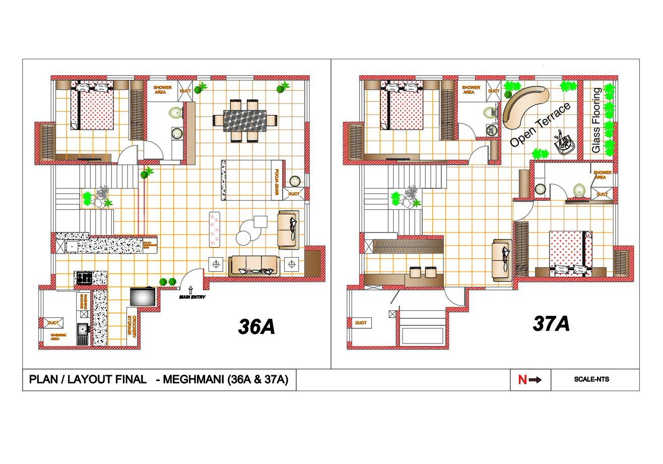
FLOOR LAYOUT PLAN
Lower Floor (36A) & Upper Floor (37A) — As Executed
Lower Floor: Guest Bedroom · Kitchen · Utility · Living & Dining · Puja | Upper Floor: Master Bedroom · Bedroom · Toilets · Open Terrace

Slide 4
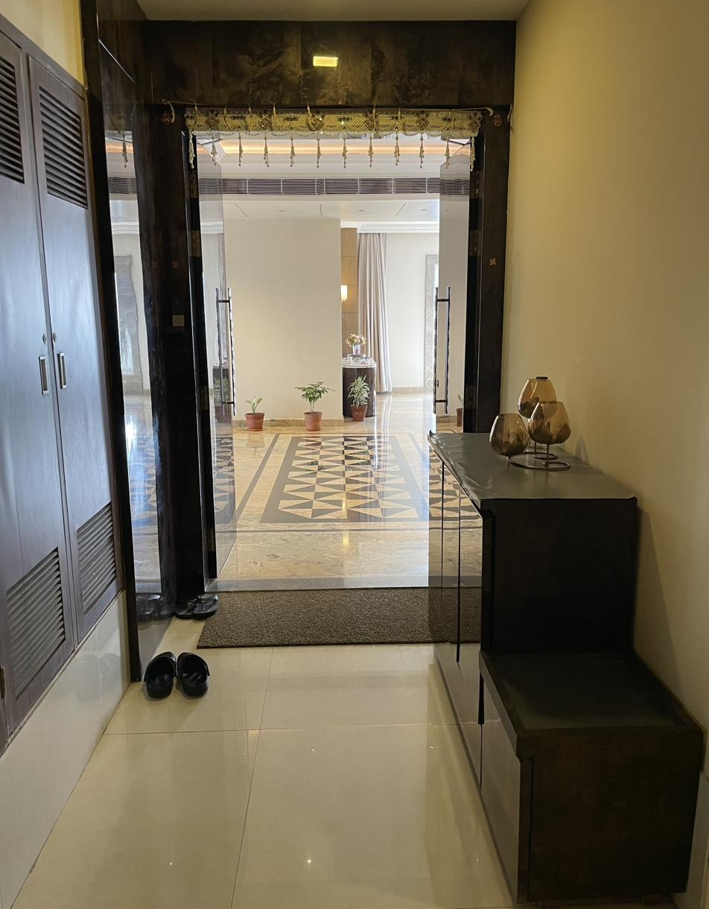
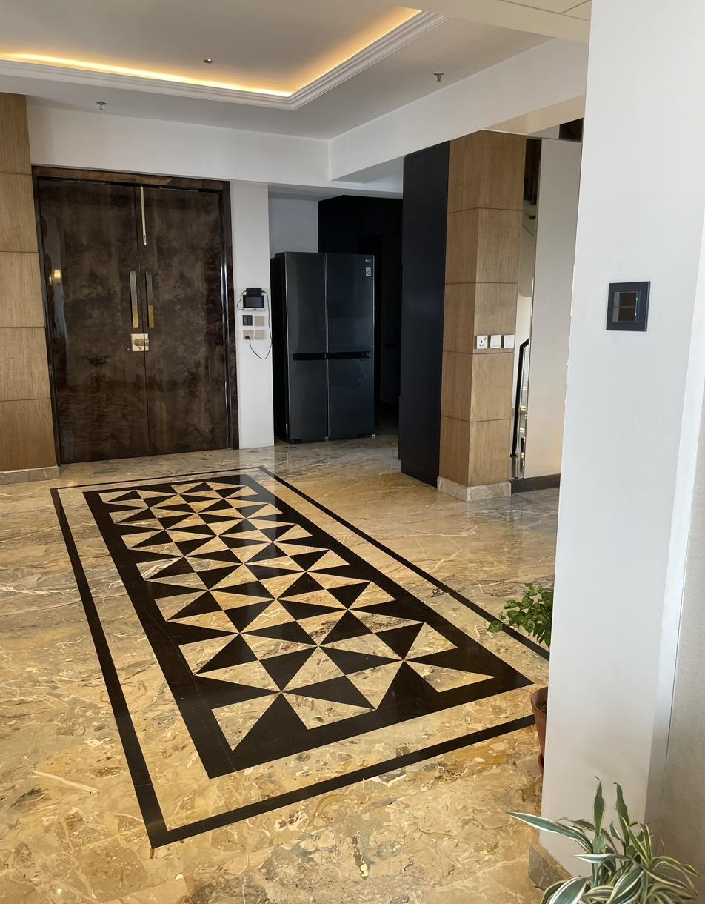
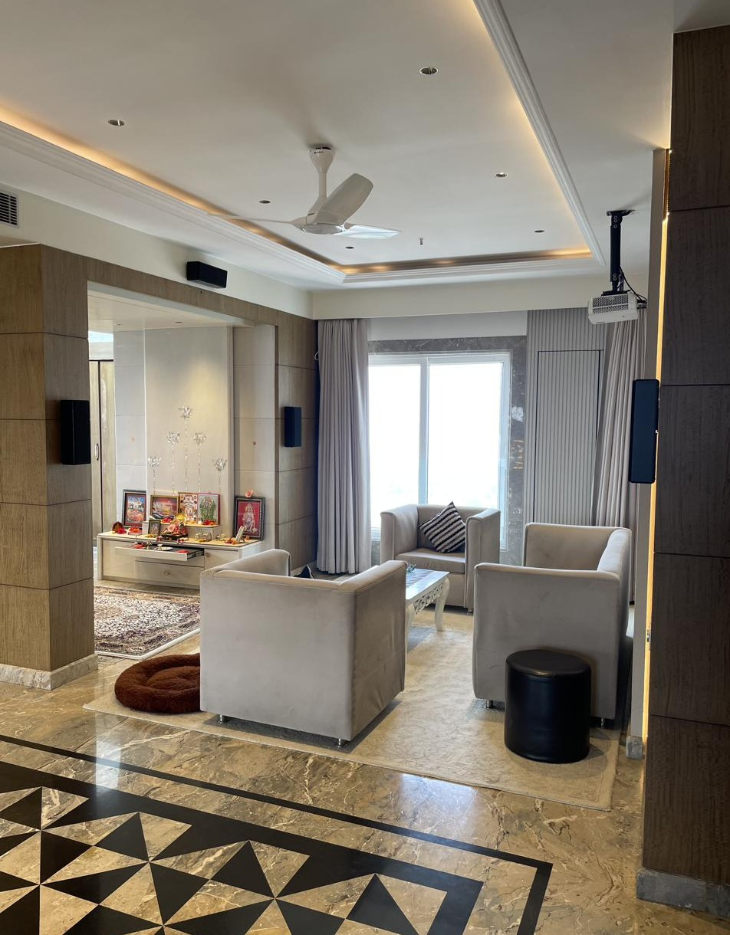
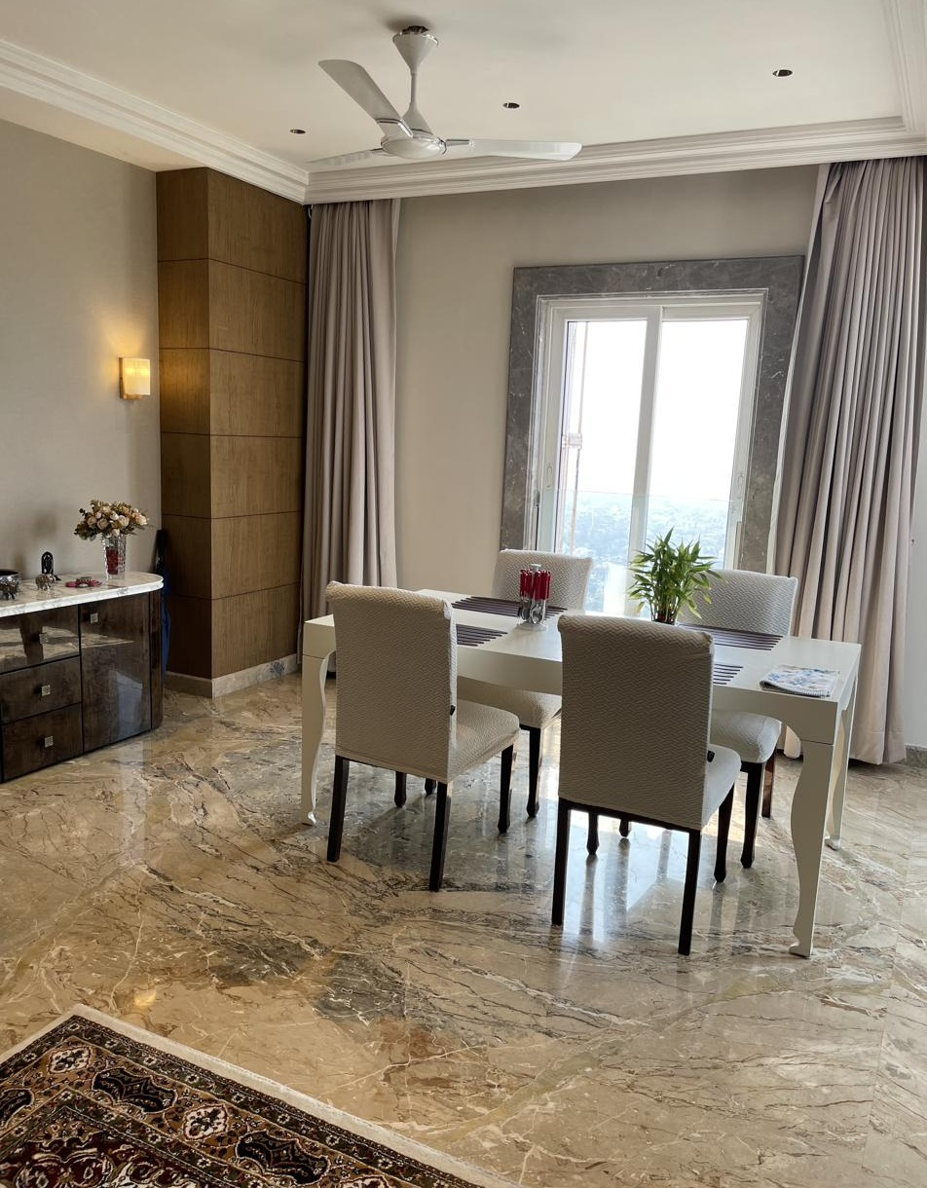
LIVING, DINING & FOYER
Execution & Finish Detail — Lower Floor
MATERIALS & VENDORS
Flooring
Italian marble, custom inlay medallion · Contractor: Suman
Furniture
Custom-made
Curtains & Upholstery
Seven Designs
Audio-Video
Watteffects
Home Automation
Schneider · Integration: BT Automation
False Ceiling
Main Entry Foyer
Foyer — Marble Inlay Flooring
Contractor: Irshad Alam
Carpentry
Century Ply Club Prime · Carpenter: Saidul Ahmed
Paint & Polish
ICA · Contractor: Sultan
Electrical
Schneider (fittings), Polycab (wiring) · Electrician: Haider
Living Area
Dining Area

Slide 5
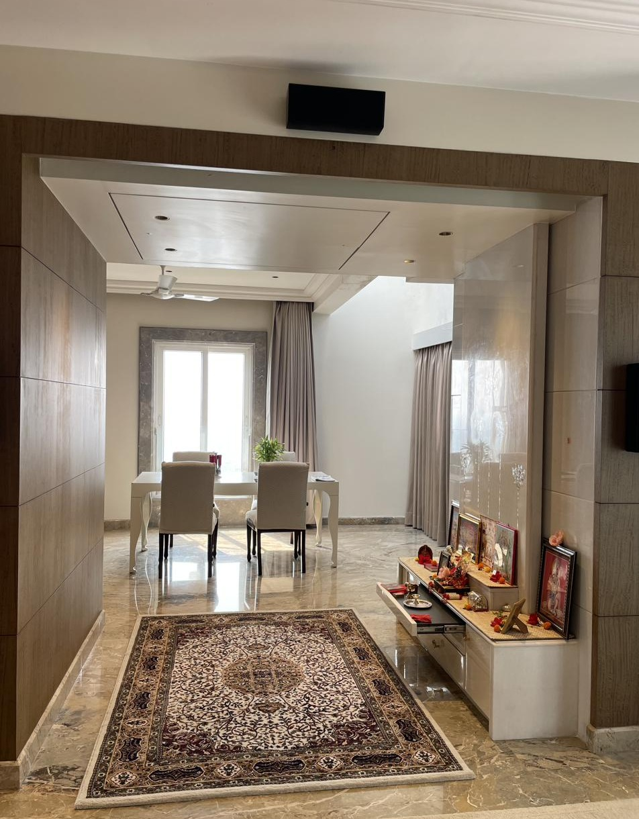
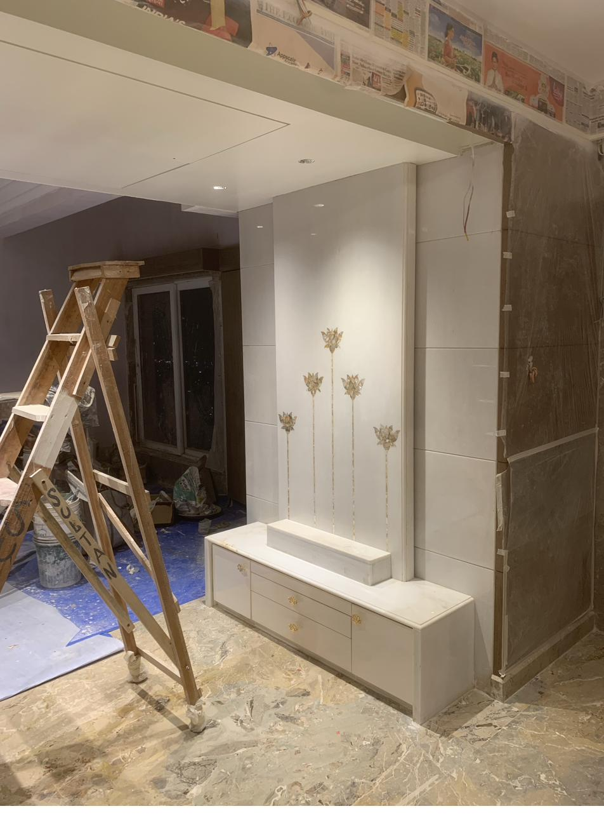
PUJA AREA
Devotional Space — Lower Floor
MATERIALS & VENDORS
Backdrop
Marble panelling with Mother of Pearl (MOP) inlay motif
Cabinetry
Custom-made · Carpenter: Saidul Ahmed
Flooring
Italian marble, continuous with Living/Dining
Lighting
Lafit — recessed accent lighting
Paint & Polish
ICA · Contractor: Sultan
Wall Finish
Imported veneer surround
Puja Unit — Marble & Custom Cabinetry
Puja Wall — Work in Progress

Slide 6
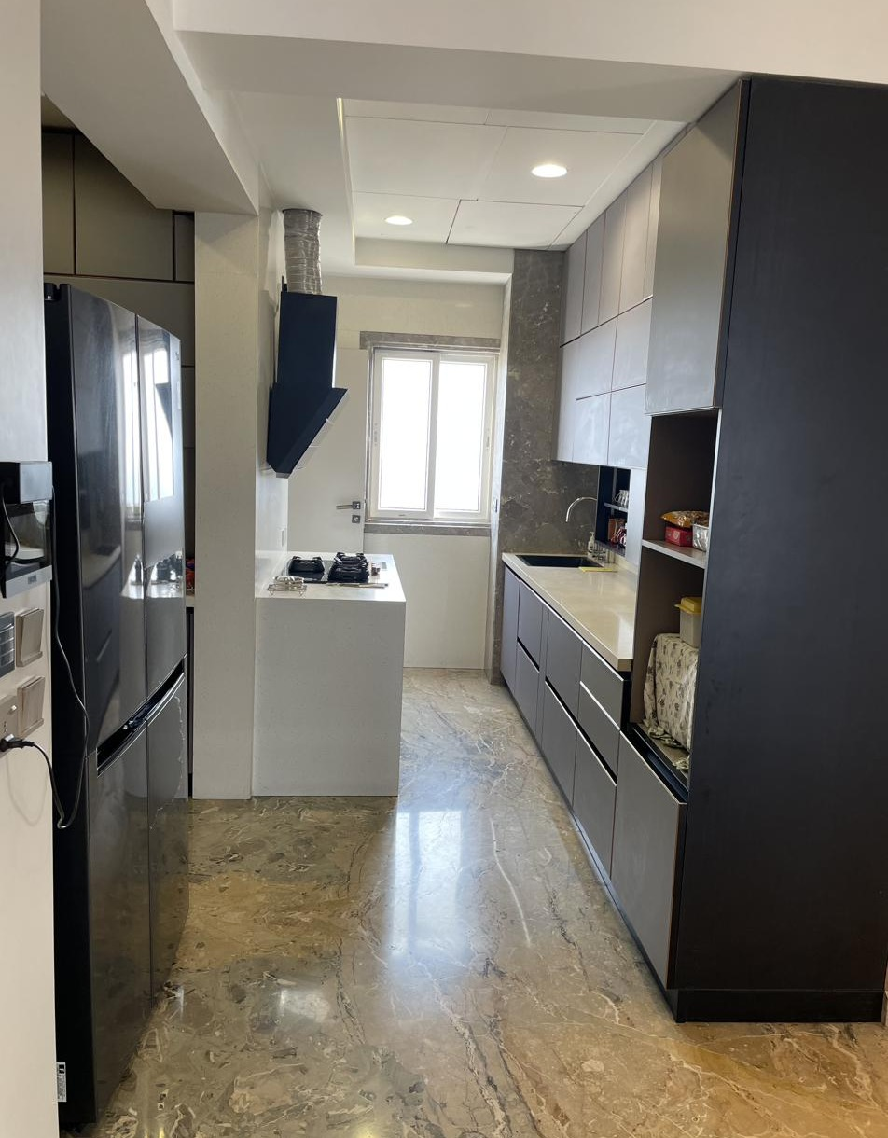
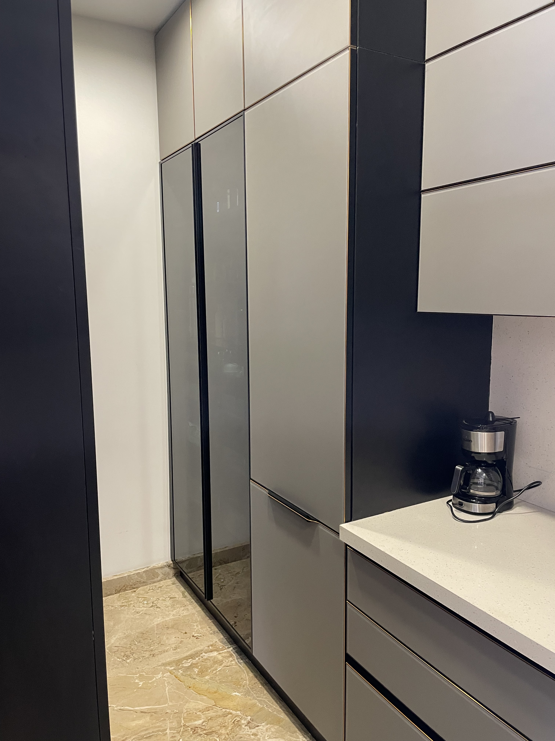
KITCHEN & PANTRY
Wet / Dry Kitchen with Pantry — Lower Floor
MATERIALS & VENDORS
Modular Kitchen
Vendor: Blu Kitchens
Kitchen Hardware
Häfele & Hettich
Refrigerator
LG
Hob & Chimney
Faber
Oven
Samsung
Flooring
Italian marble
Electrical
Schneider · Electrician: Haider
Plumbing
Cooking & Storage
Pantry Detail
Contractor: Vikram
Carpentry
Century Ply Club Prime · Carpenter: Saidul Ahmed

Slide 7
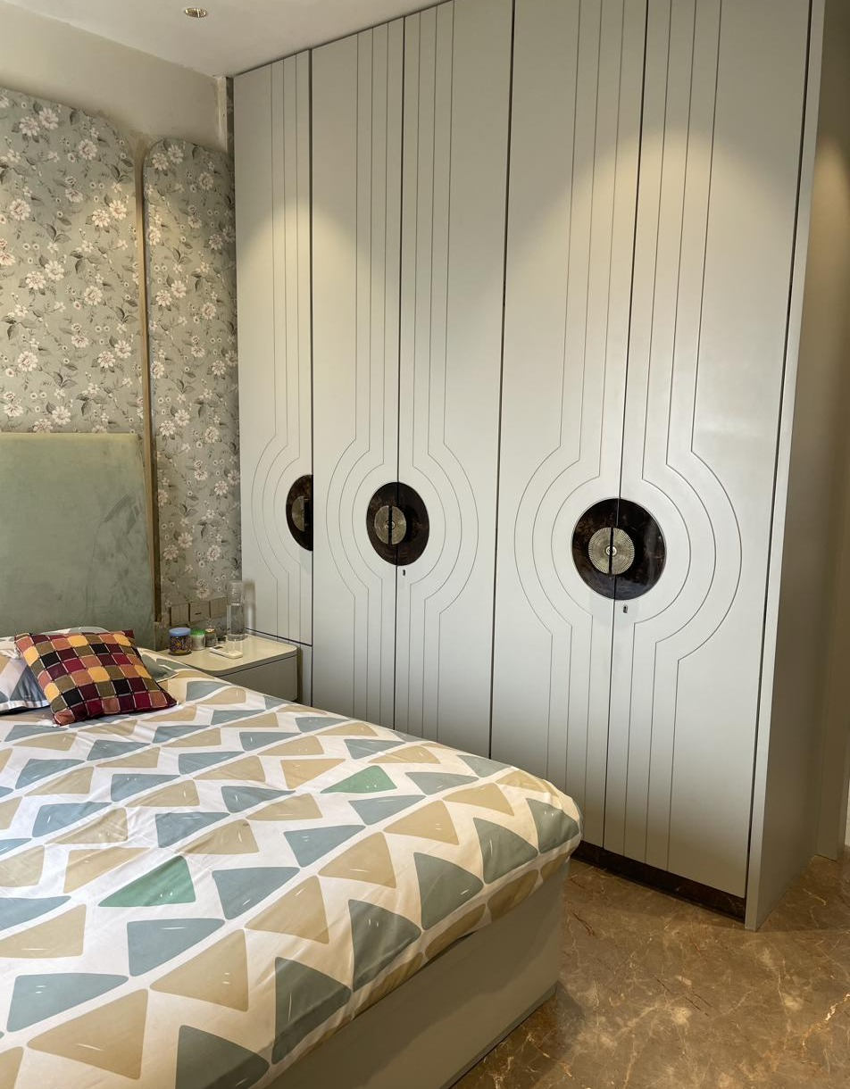
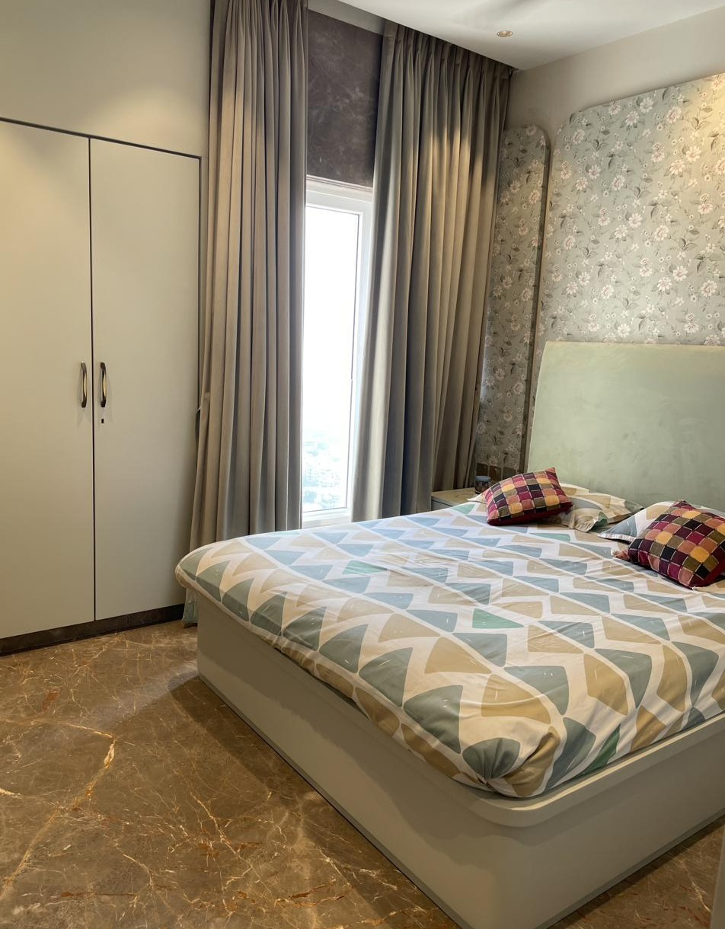
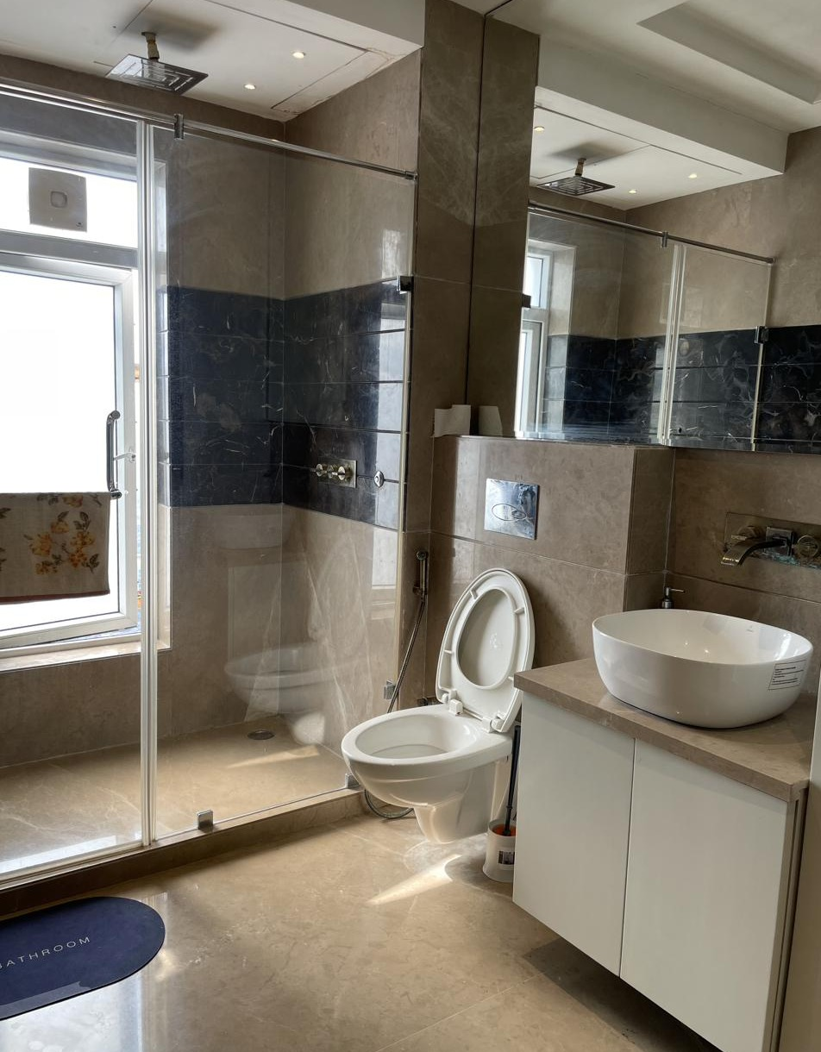
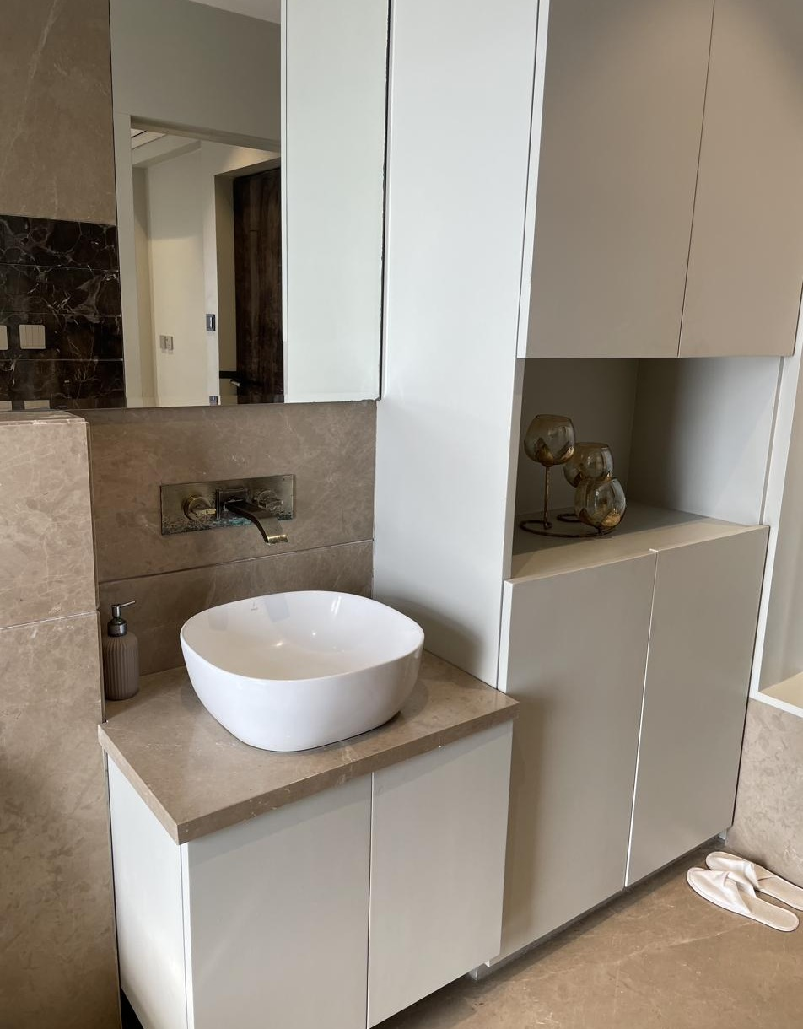
GUEST BEDROOM & BATH
Lower Floor
MATERIALS & VENDORS
Wallpaper
Sabyasachi
Sanitaryware & Fittings
Kohler & Jaquar Artize
Bath Flooring/Cladding
Italian marble
Curtains & Upholstery
Seven Designs
Wardrobe
Custom carpentry · Century Ply Club Prime
Guest Bedroom — Wallpaper & Wardrobe
Guest Bedroom — Bed & Curtains
Plumbing
Contractor: Vikram
Paint & Polish
ICA · Contractor: Sultan
Guest Bath — Shower Enclosure
Guest Bath — Vanity Detail

Slide 8
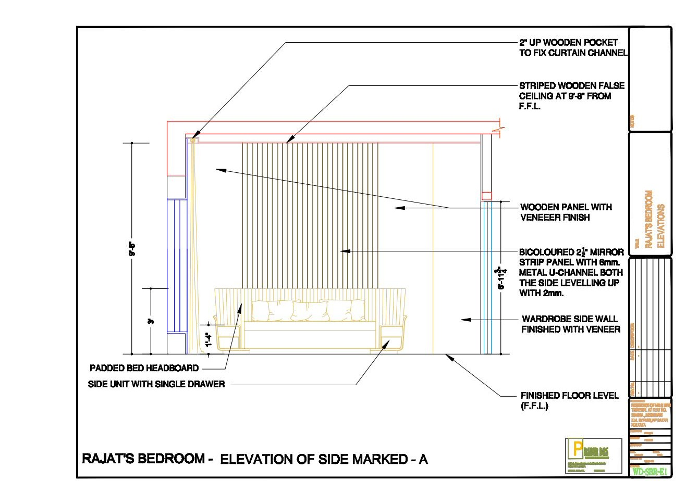
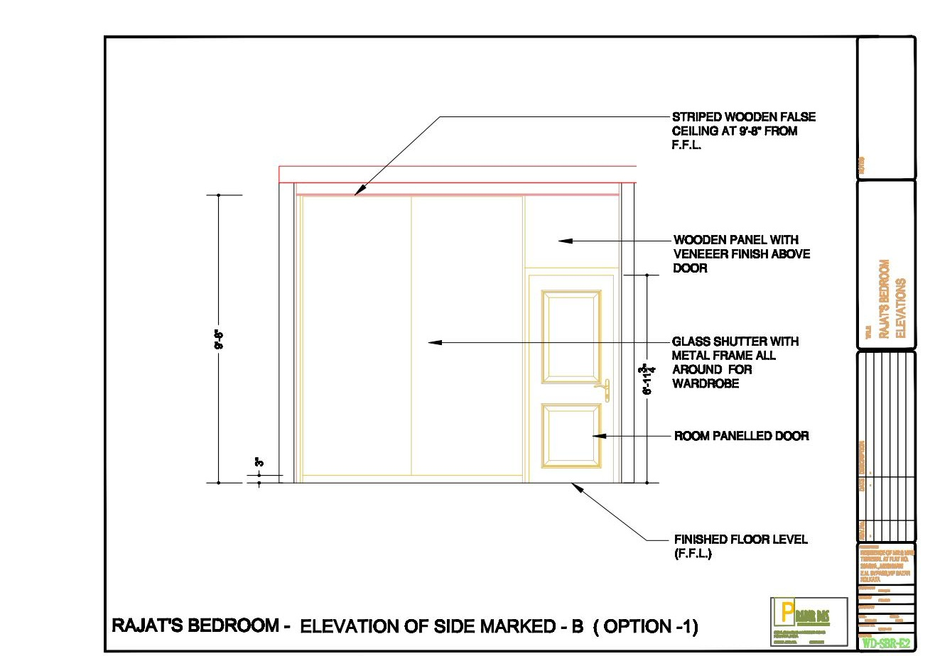
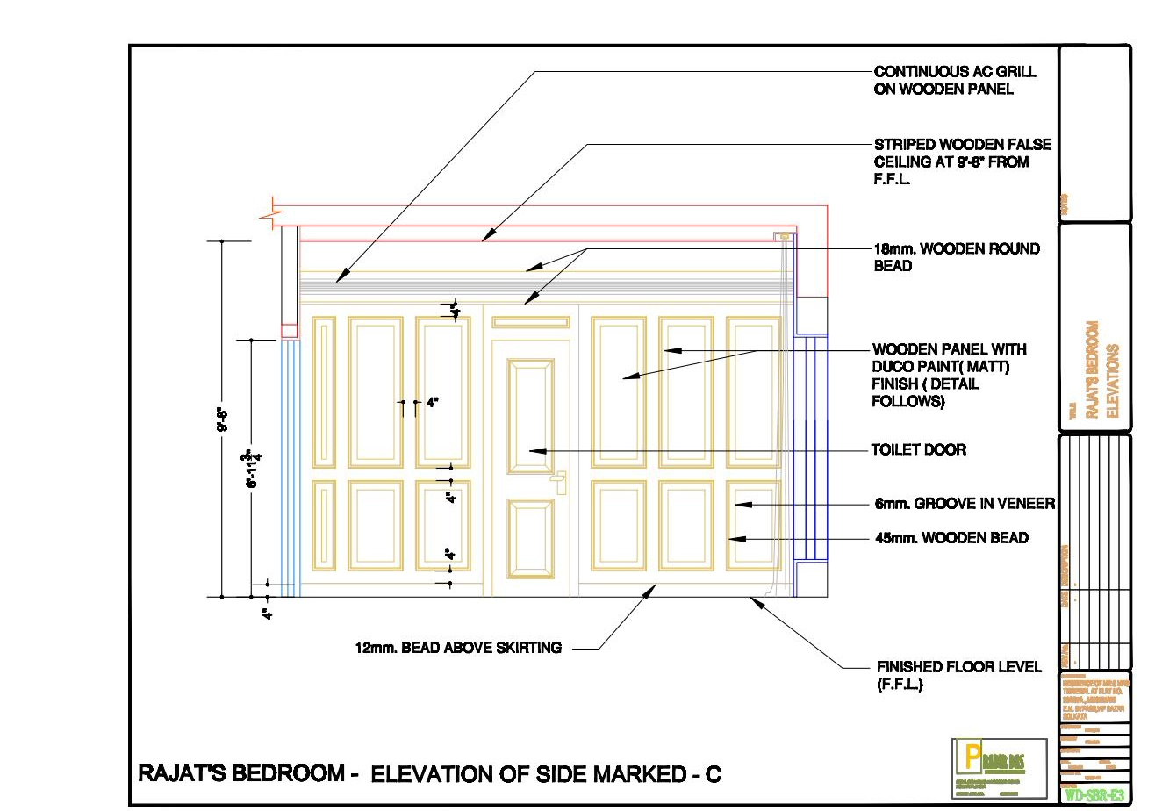
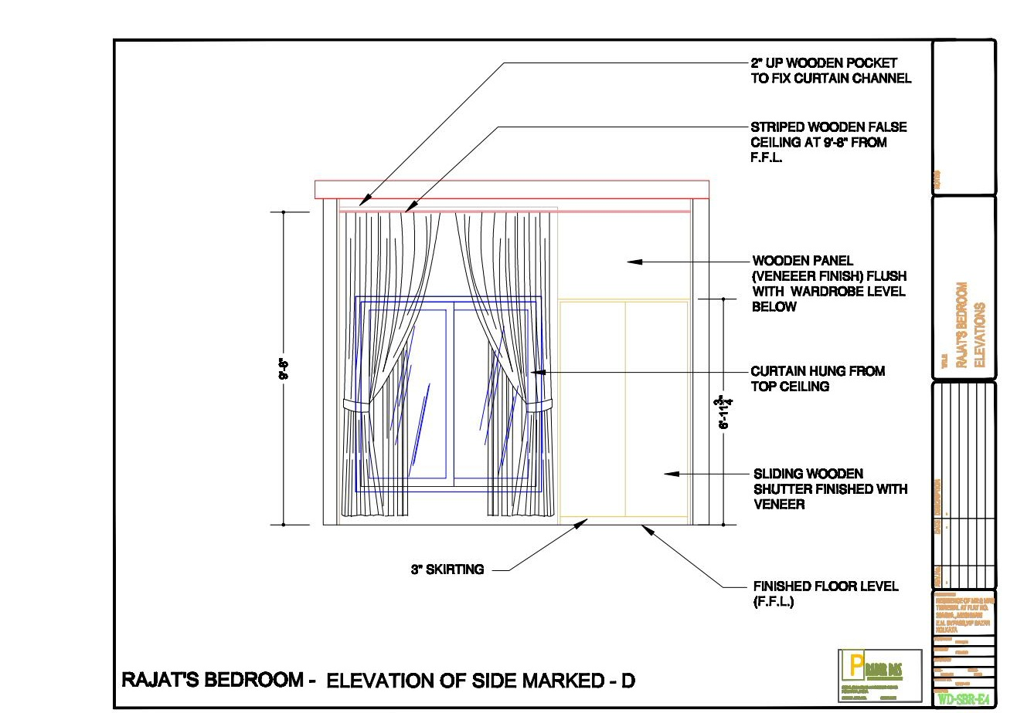
RAJAT'S BEDROOM — ELEVATION DRAWINGS
Design Development — Sides A to D
Side A
Side B
Side C
Side D
Elevation set issued for execution — headboard, wardrobe & window wall detailing

Slide 9
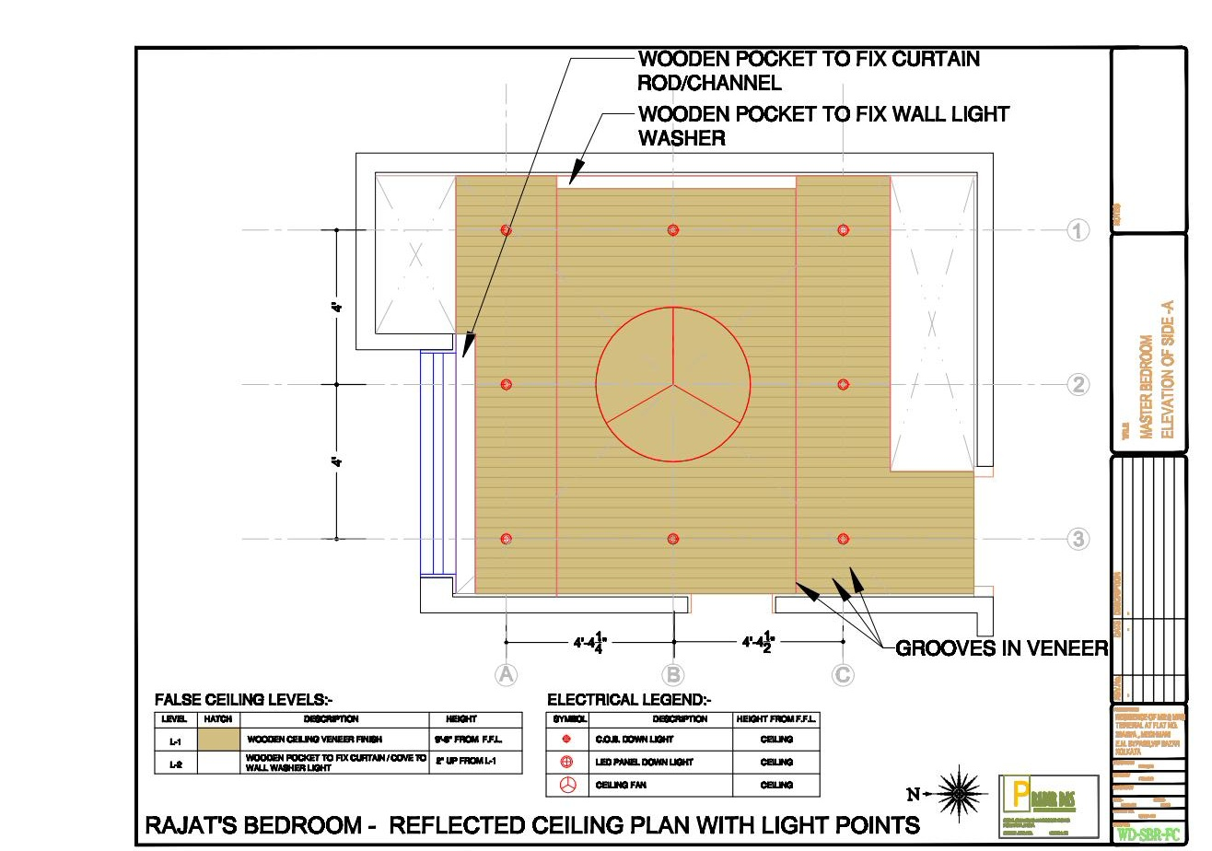
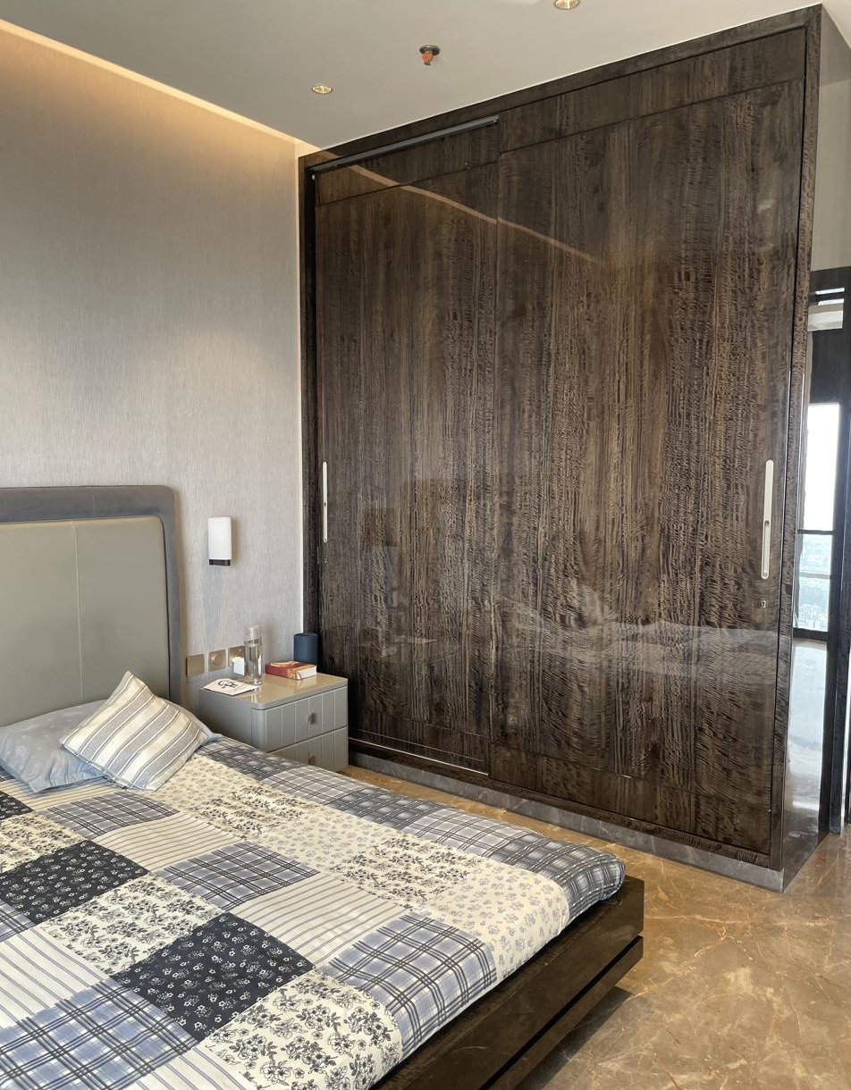
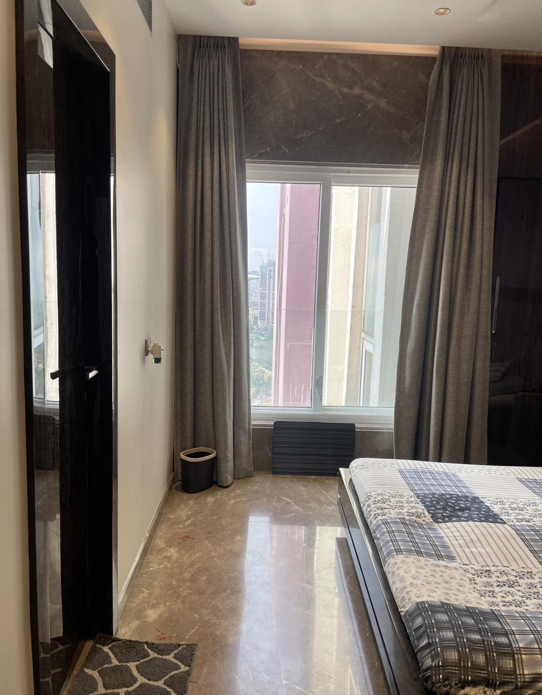
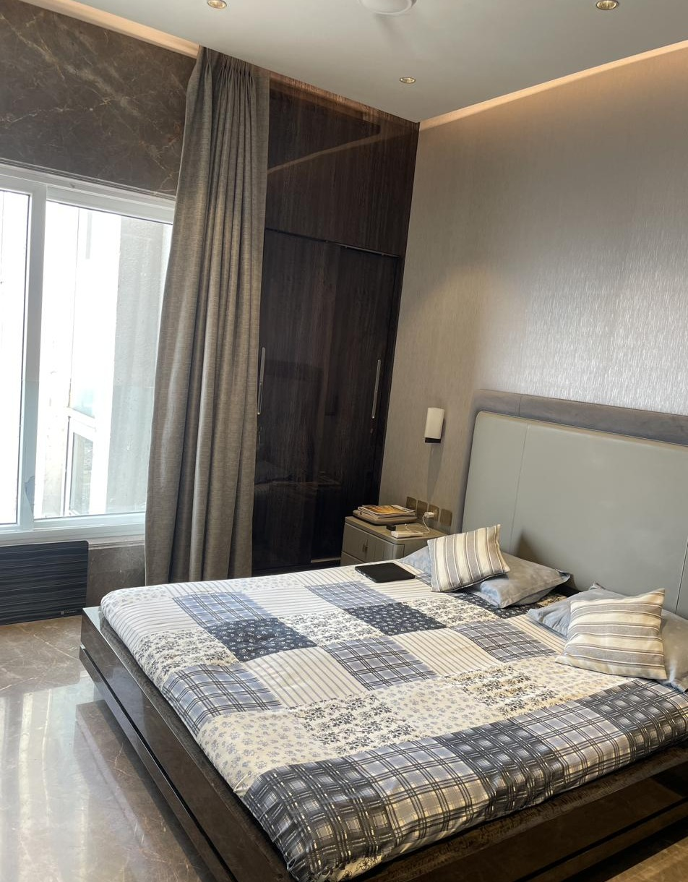
RAJAT'S BEDROOM
Ceiling Plan & Execution — Upper Floor
MATERIALS & VENDORS
False Ceiling
Contractor: Irshad Alam
Wardrobe & Panelling
Century Ply Club Prime · Carpenter: Saidul Ahmed
Curtains & Upholstery
Seven Designs
Flooring
Italian marble
Lighting
Lafit
False Ceiling Plan
Wardrobe Wall — Executed
Electrical
Schneider · Electrician: Haider
Paint & Polish
ICA · Contractor: Sultan
Window & Curtain Wall
Bed & Headboard

Slide 10
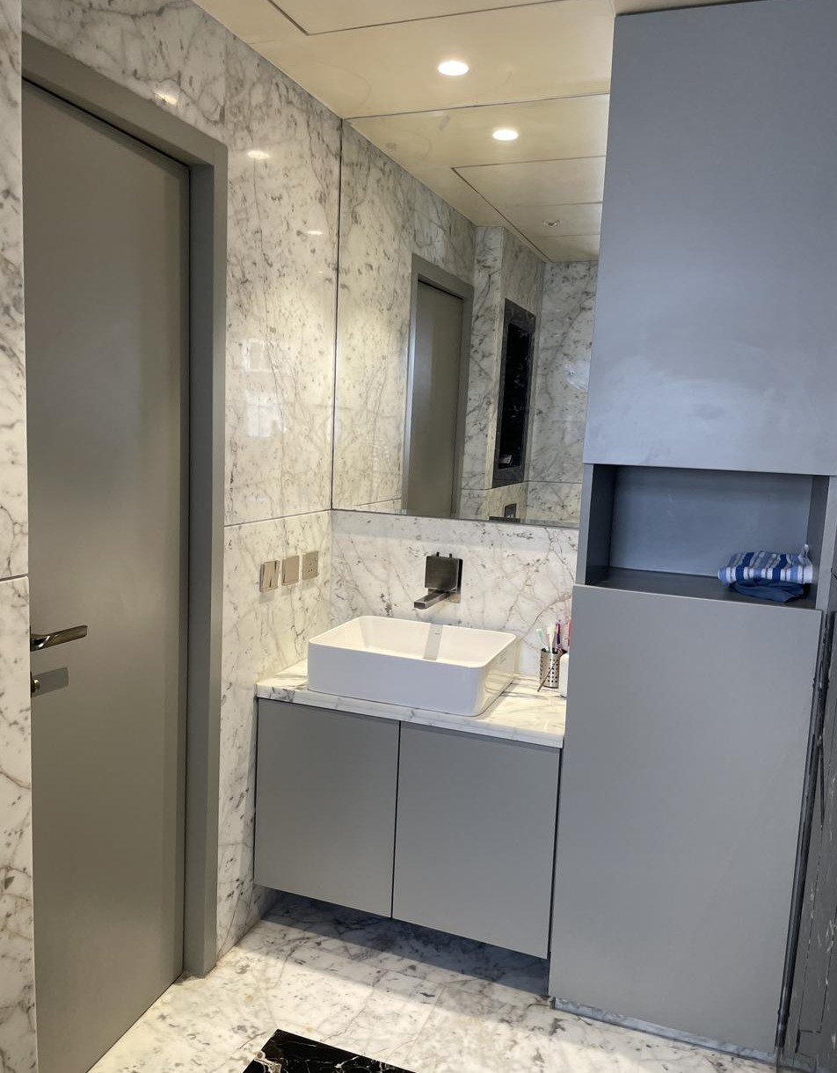
RAJAT'S BATHROOM
En-suite — Upper Floor
MATERIALS & VENDORS
Wall & Floor Cladding
Italian marble (Carrara-style)
Sanitaryware & Fittings
Kohler & Jaquar Artize
Vanity
Custom-made, matte lacquer finish
Plumbing
Contractor: Vikram
Electrical
Schneider · Electrician: Haider
Waterproofing
Executed prior to tiling/marble fixing
Vanity & Storage

Slide 11
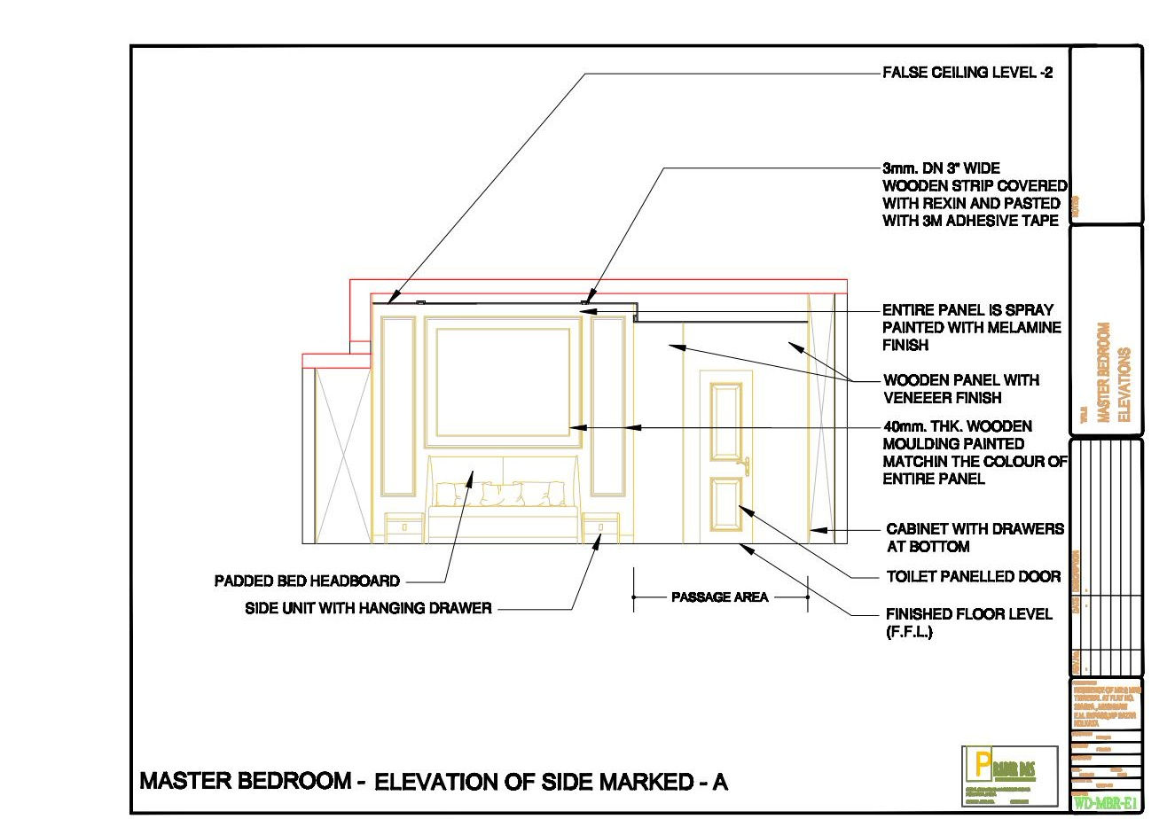
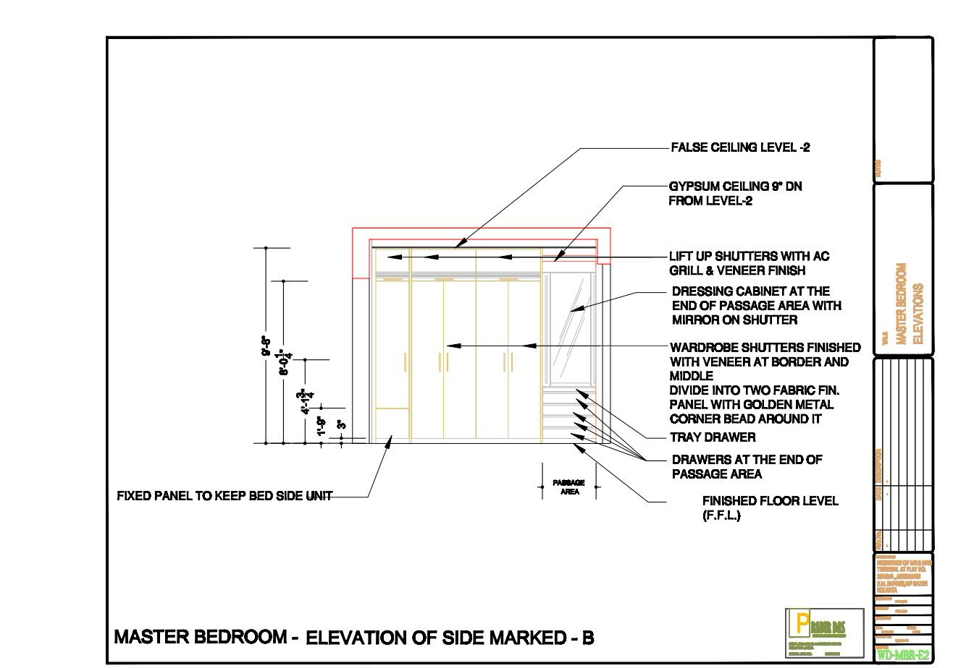
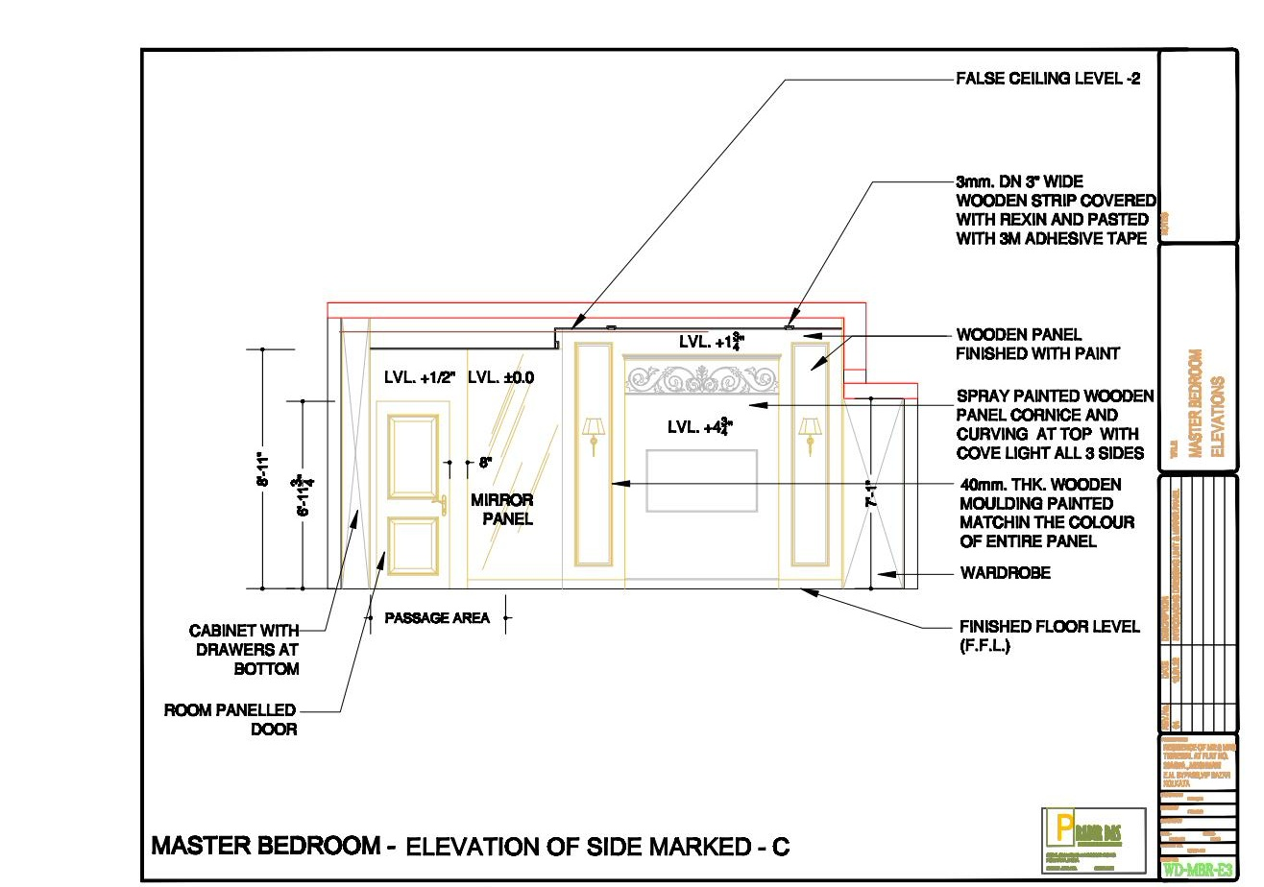
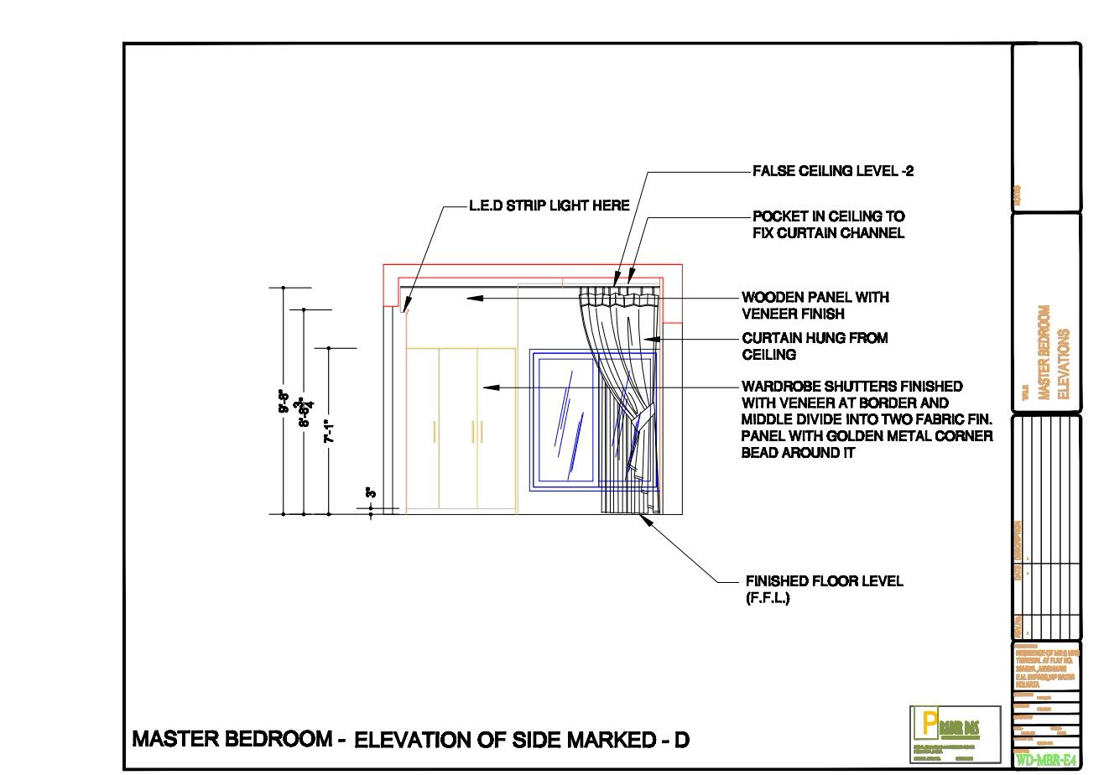
MASTER BEDROOM — ELEVATION DRAWINGS
Design Development — Sides A to D
Side A
Side B
Side C
Side D
Elevation set issued for execution — headboard wall, wardrobe & window wall detailing

Slide 12
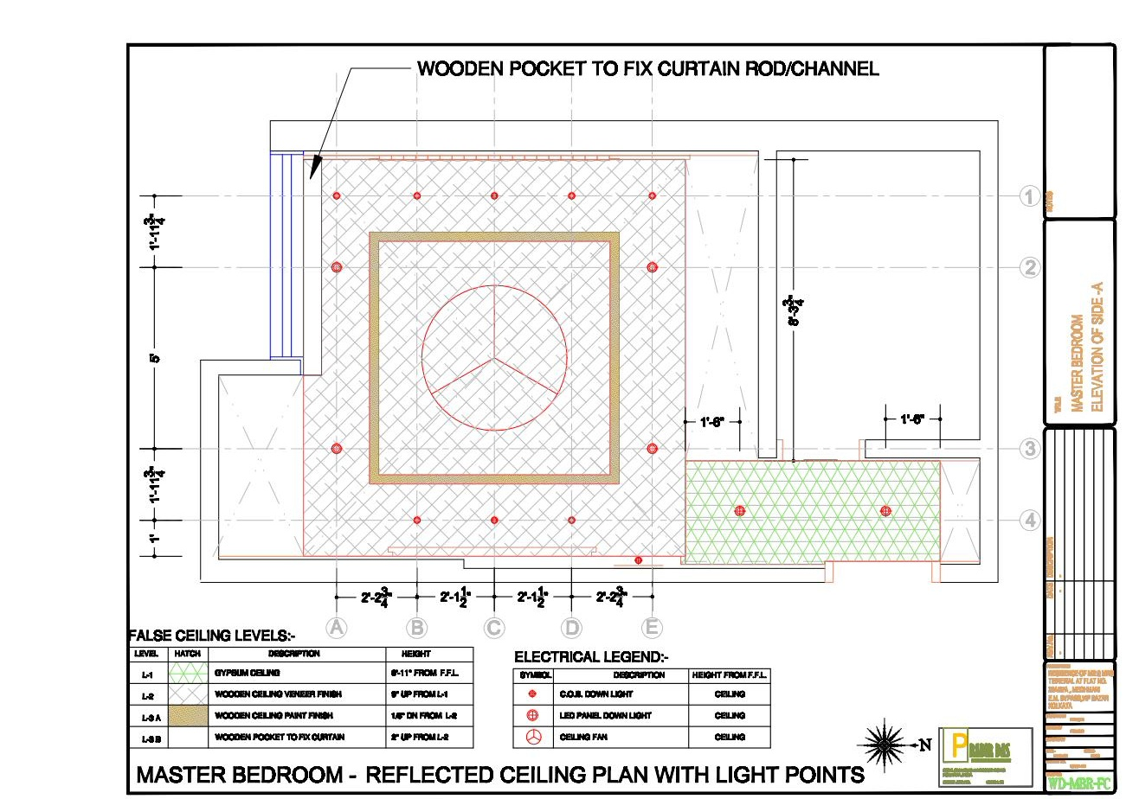
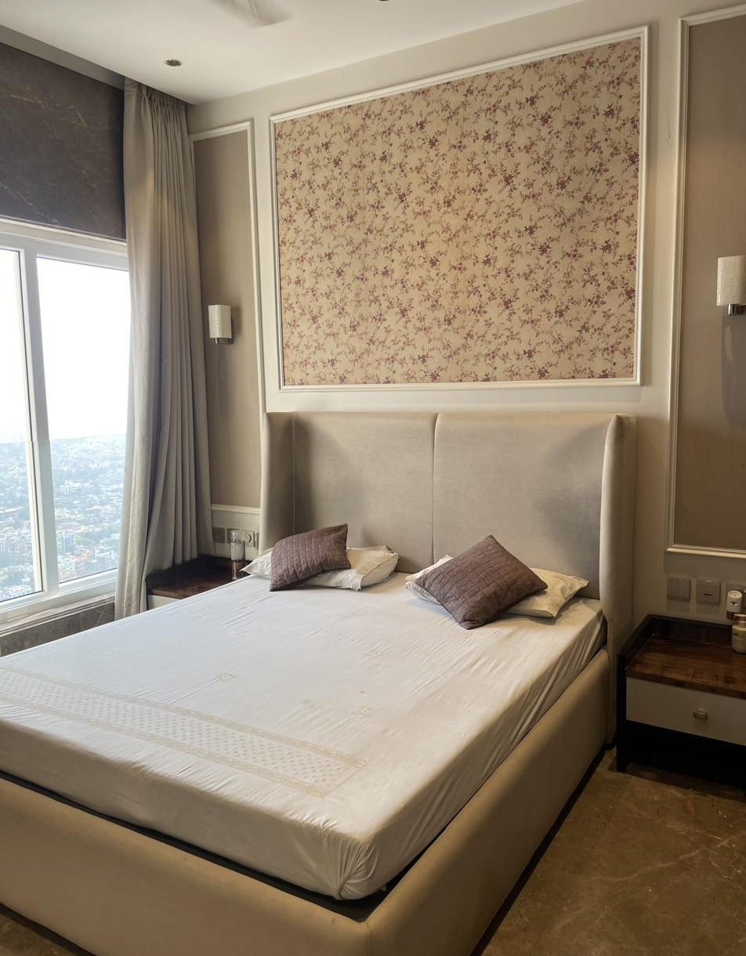
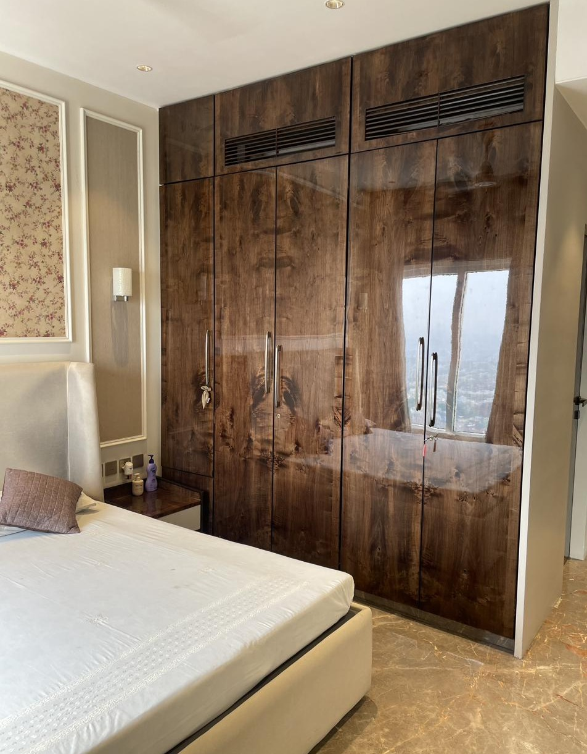
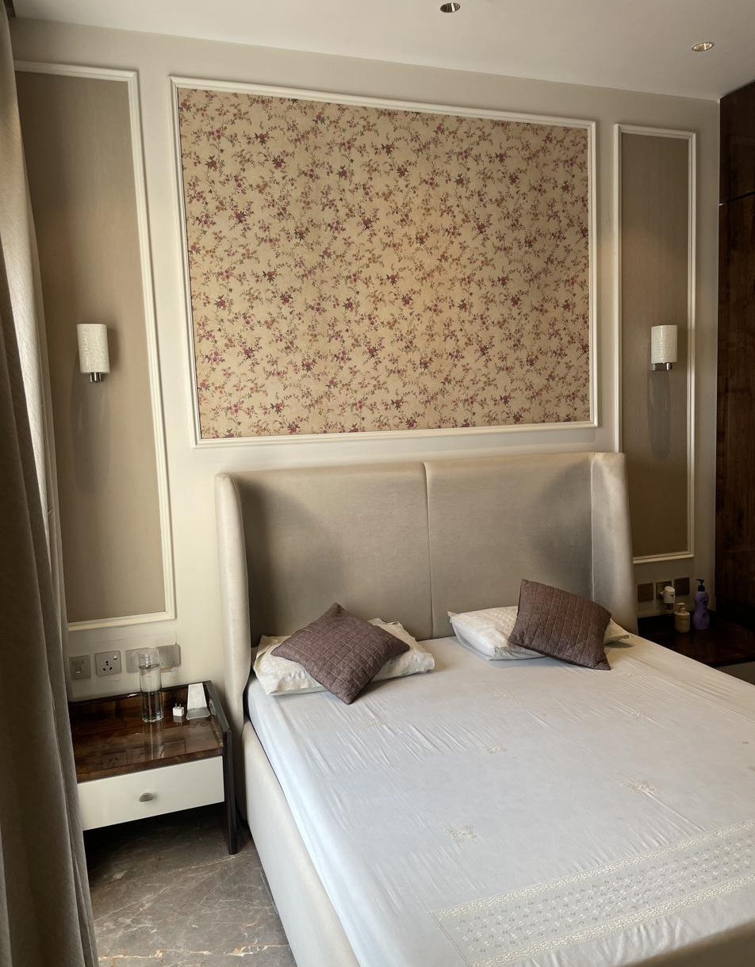
MASTER BEDROOM
Ceiling Plan & Execution — Upper Floor
MATERIALS & VENDORS
False Ceiling
Contractor: Irshad Alam
Wallpaper
Sabyasachi
Wardrobe & Panelling
Imported veneer · Century Ply Club Prime
Carpentry
Carpenter: Saidul Ahmed
Curtains & Upholstery
Seven Designs
False Ceiling Plan
Headboard Wall — Wallpaper Panel
Flooring
Italian marble
Electrical
Schneider · Electrician: Haider
Paint & Polish
ICA · Contractor: Sultan
Wardrobe — Veneer Finish
Bed & Nightstand Detail

Slide 13
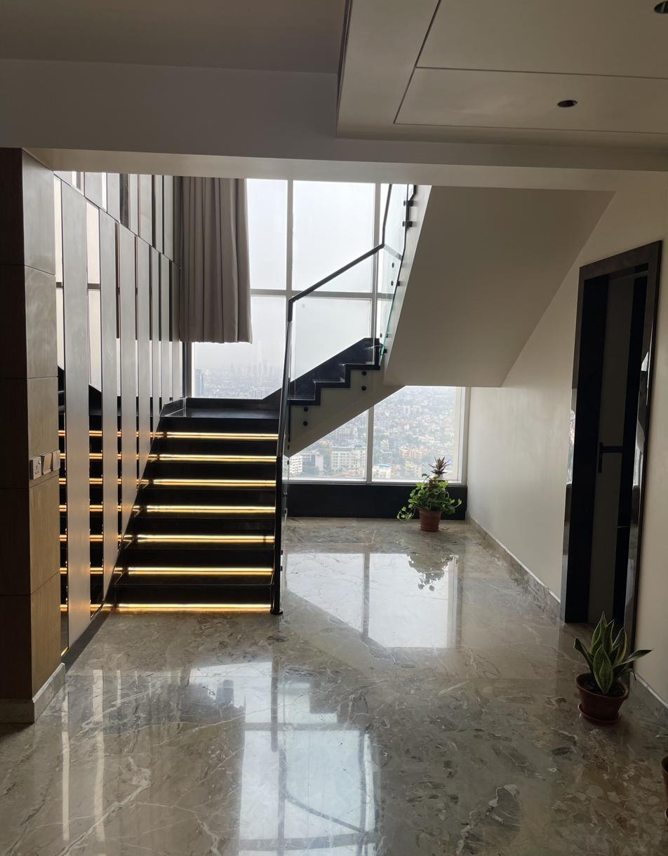
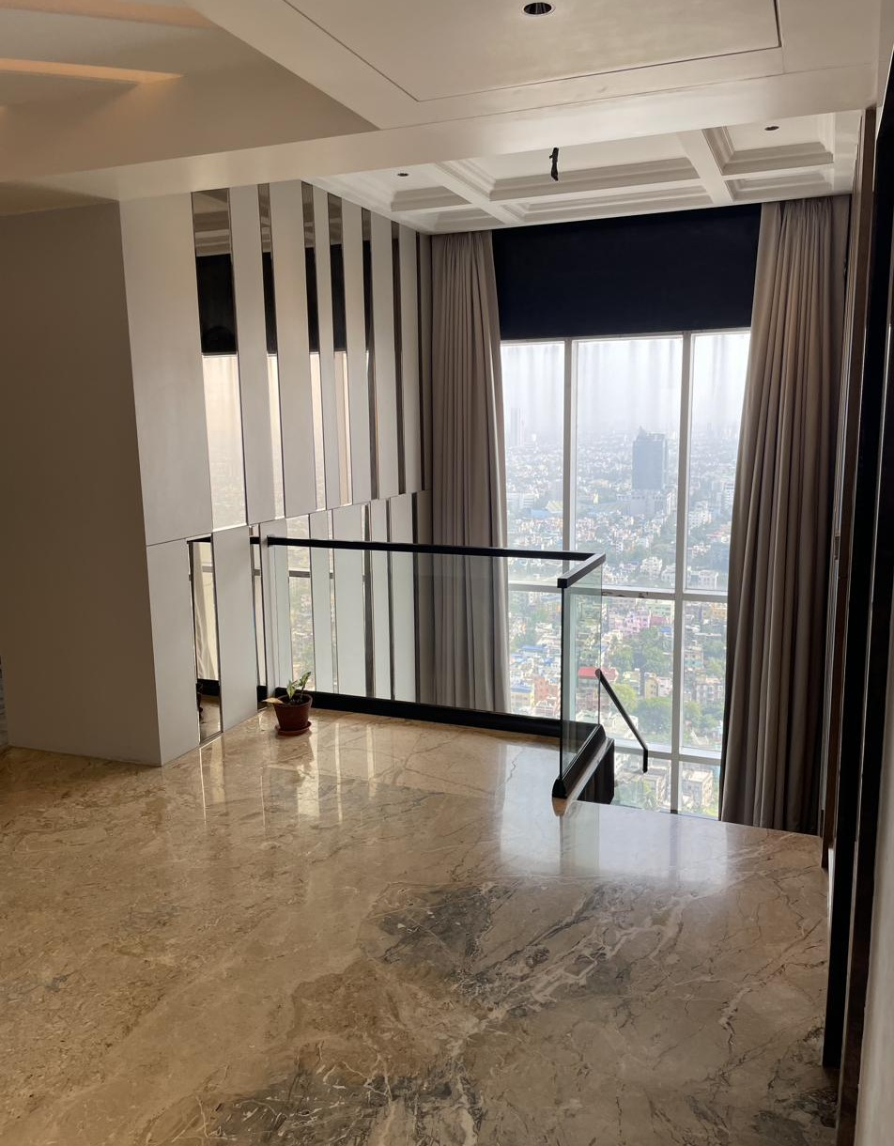
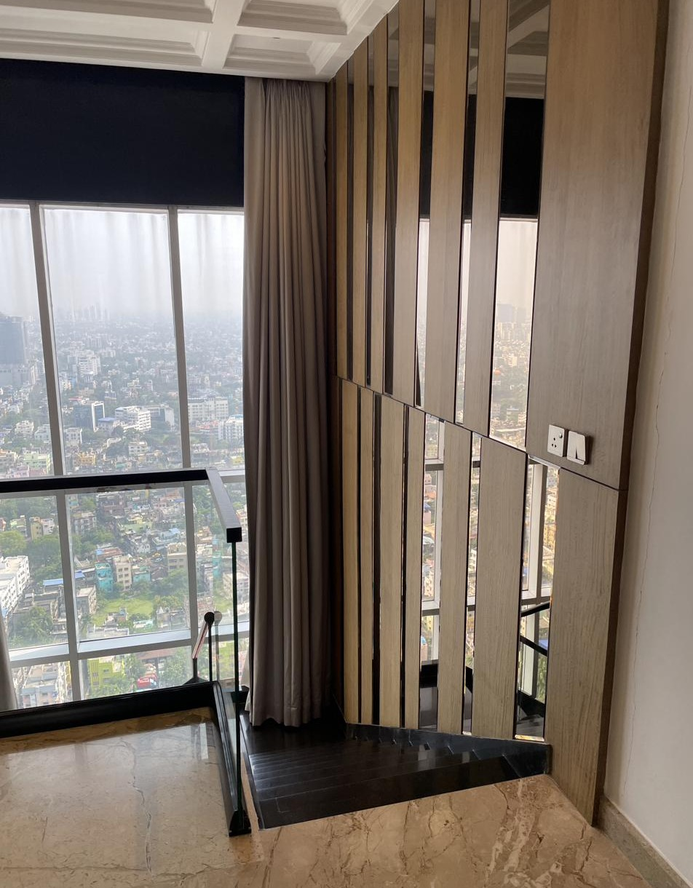
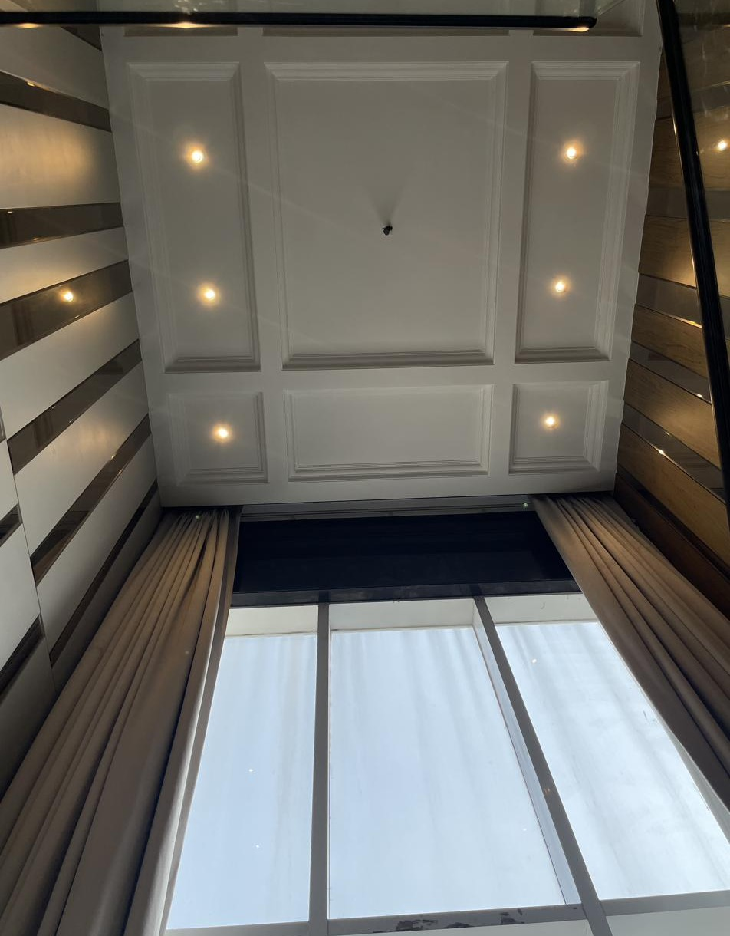
STAIRCASE & DOUBLE-HEIGHT FEATURE
Internal Connect — 36th to 37th Floor
MATERIALS & VENDORS
Staircase Structure
Steel-framed, marble-clad treads with glass balustrade
Wall Panelling
Imported veneer with mirror fin detailing
Curtains
Seven Designs — full-height drapery
Lighting
Lafit — step and cove lighting
False Ceiling
Coffered design · Contractor: Irshad Alam
Floating Staircase — City Backdrop
Landing — Mirror Panelling
Flooring
Italian marble
Wood & Mirror Fin Detail
Coffered Ceiling Above Stair

Slide 14
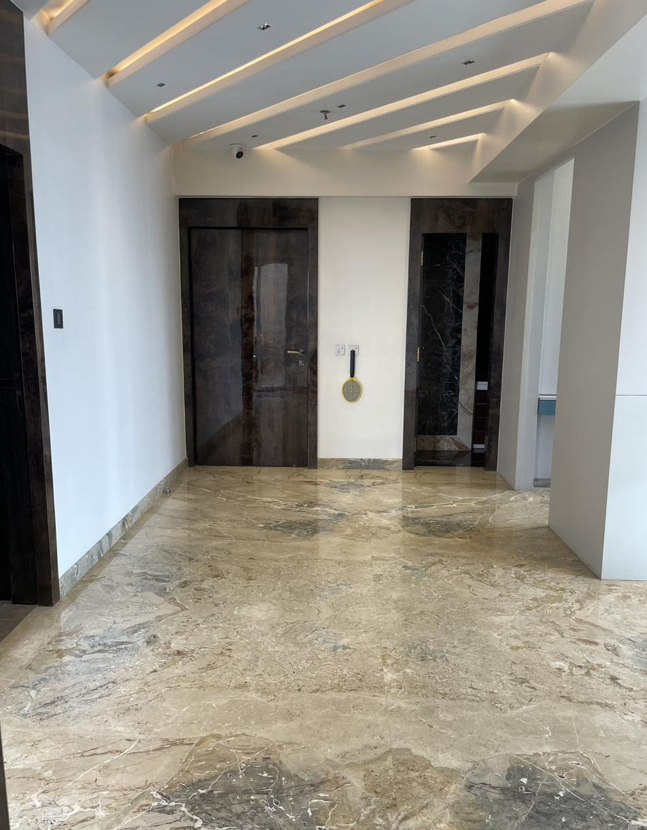
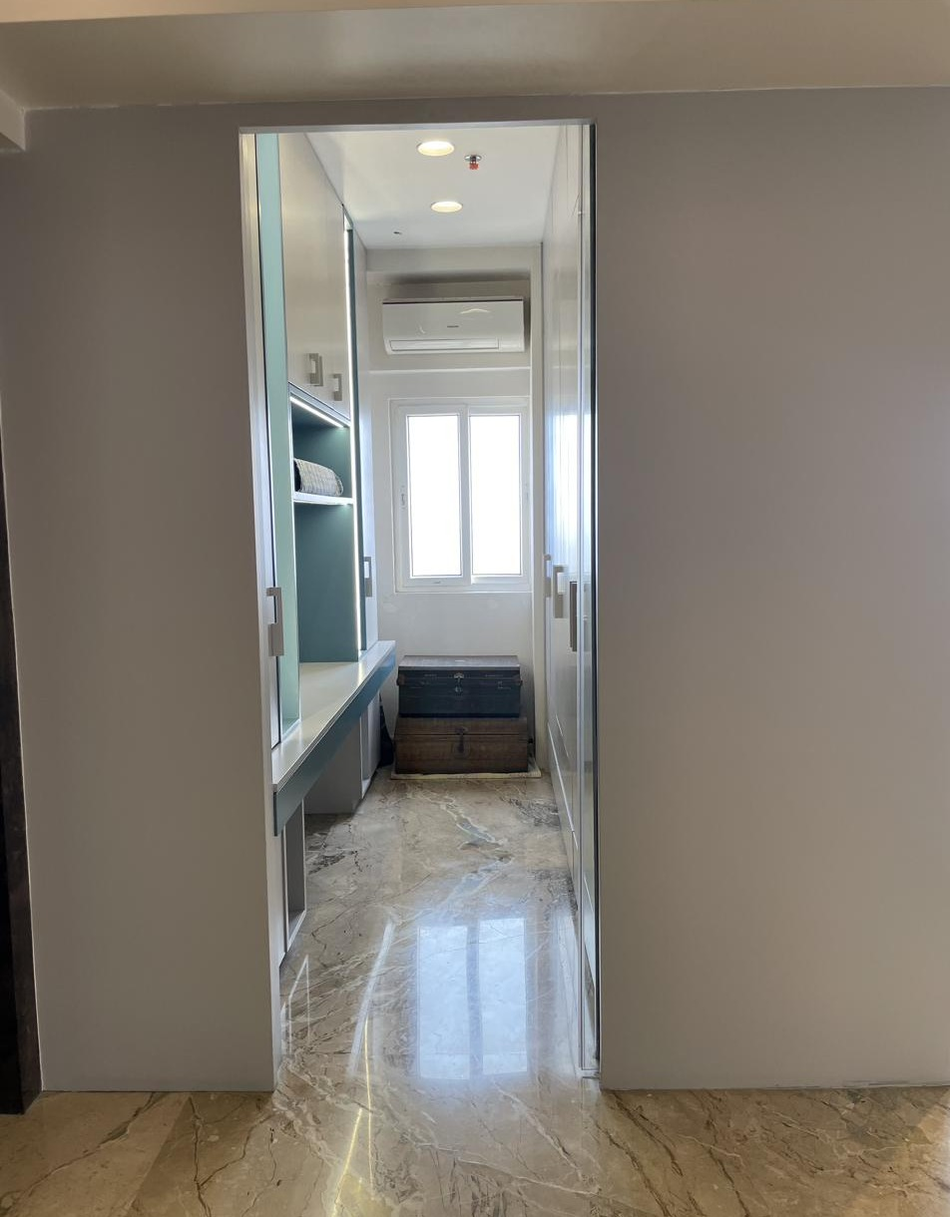
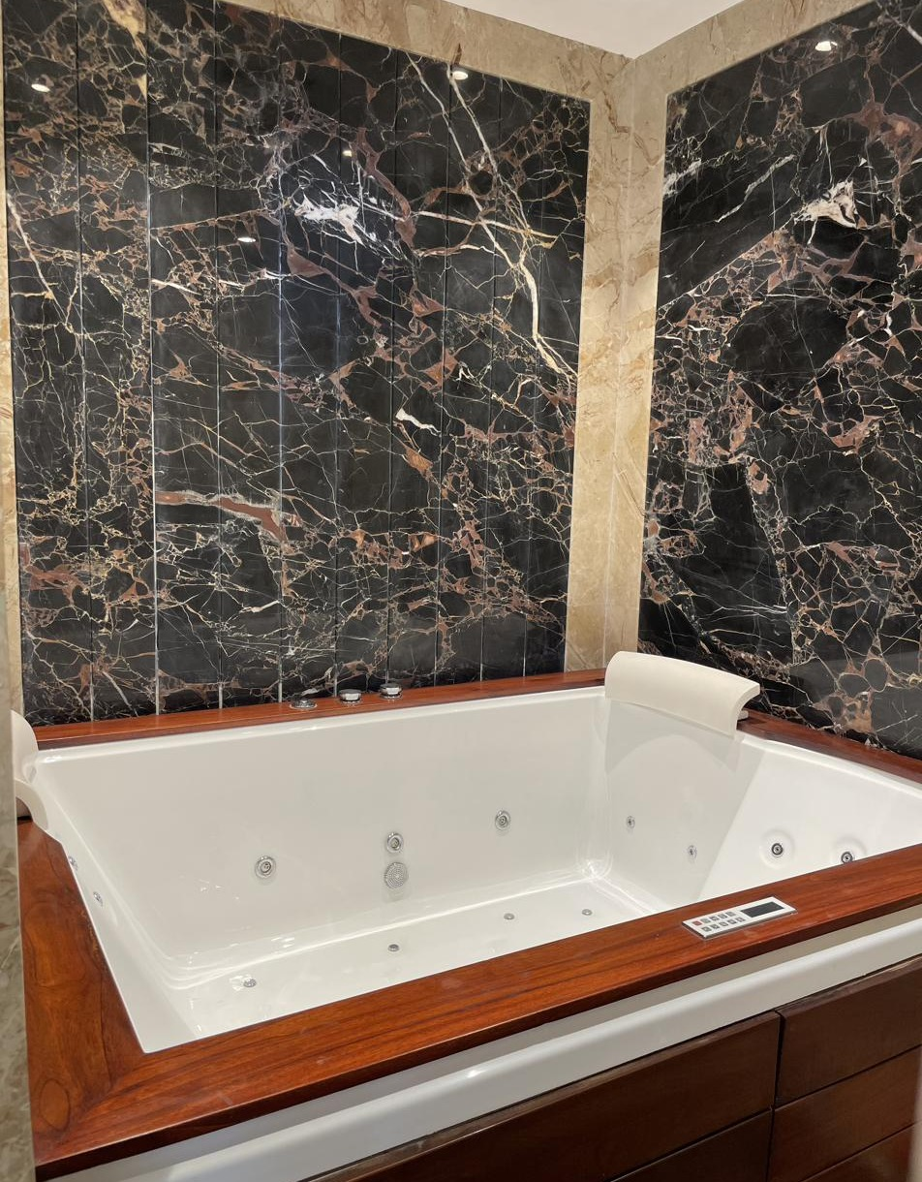
37TH FLOOR — LIVING, STUDY & JACUZZI
Upper Floor Informal Living
MATERIALS & VENDORS
Jacuzzi
Oyster
Jacuzzi Surround
Black marble with timber deck edge
Study Cabinetry
Custom-made · Century Ply Club Prime
AV & Entertainment
Informal Living / Entry
Walk-in / Study Unit
BenQ projector, ELAC speakers, Denon AV receiver · Watteffects
Flooring
Italian marble
Electrical
Schneider · Electrician: Haider
Jacuzzi Room — Marble Surround

Slide 15
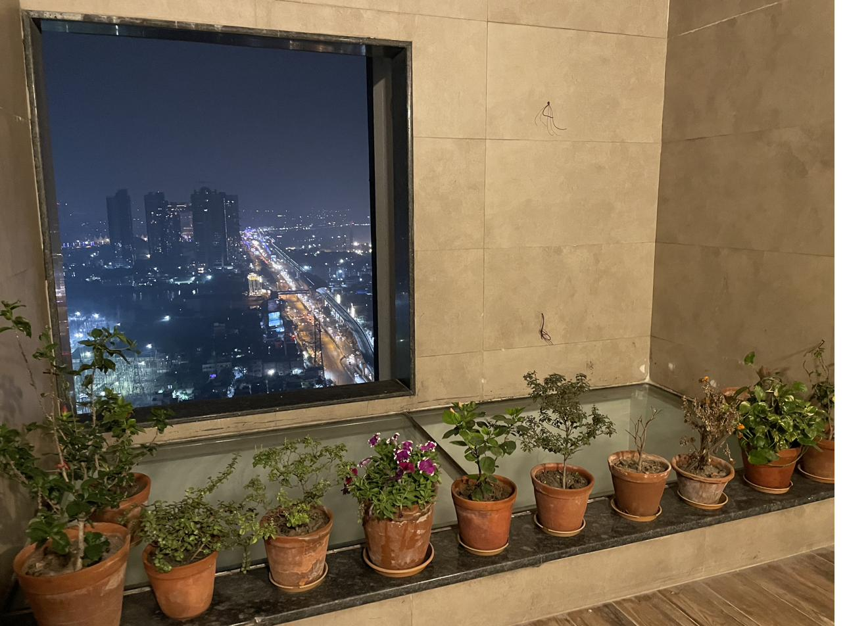
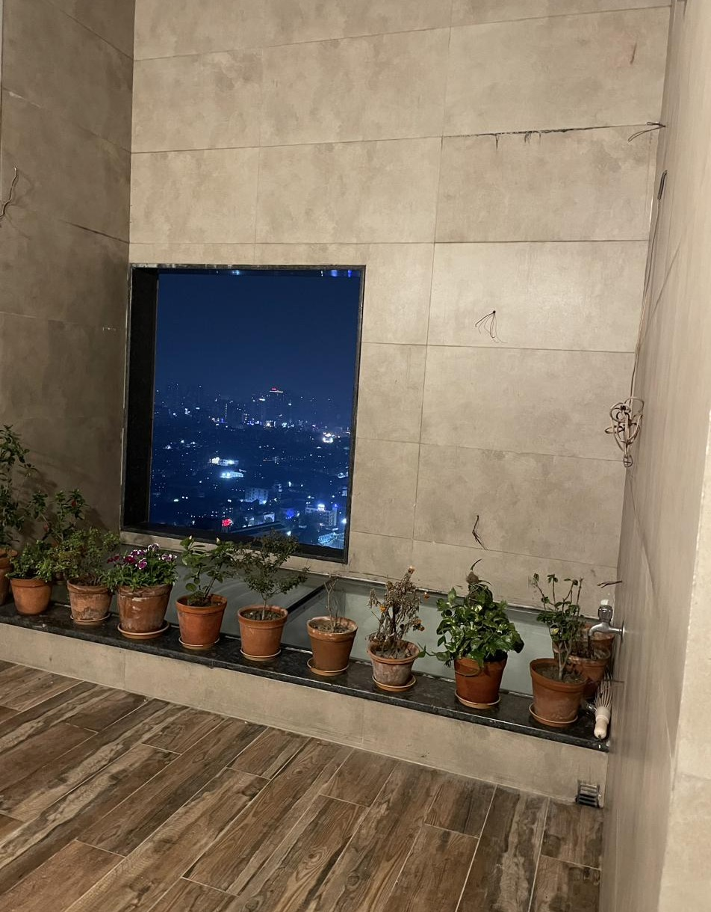
OPEN TERRACE
37th Floor — Landscaped Deck
MATERIALS & VENDORS
Flooring
Outdoor wood-finish tile + glass flooring section
Landscaping
Potted garden — curated plant selection
Cladding
Textured stone-finish tile
Waterproofing
Executed prior to flooring/landscaping
Lighting
Lafit — weatherproof fittings
Terrace Garden — City View
Terrace — Glass Flooring Detail

Slide 16
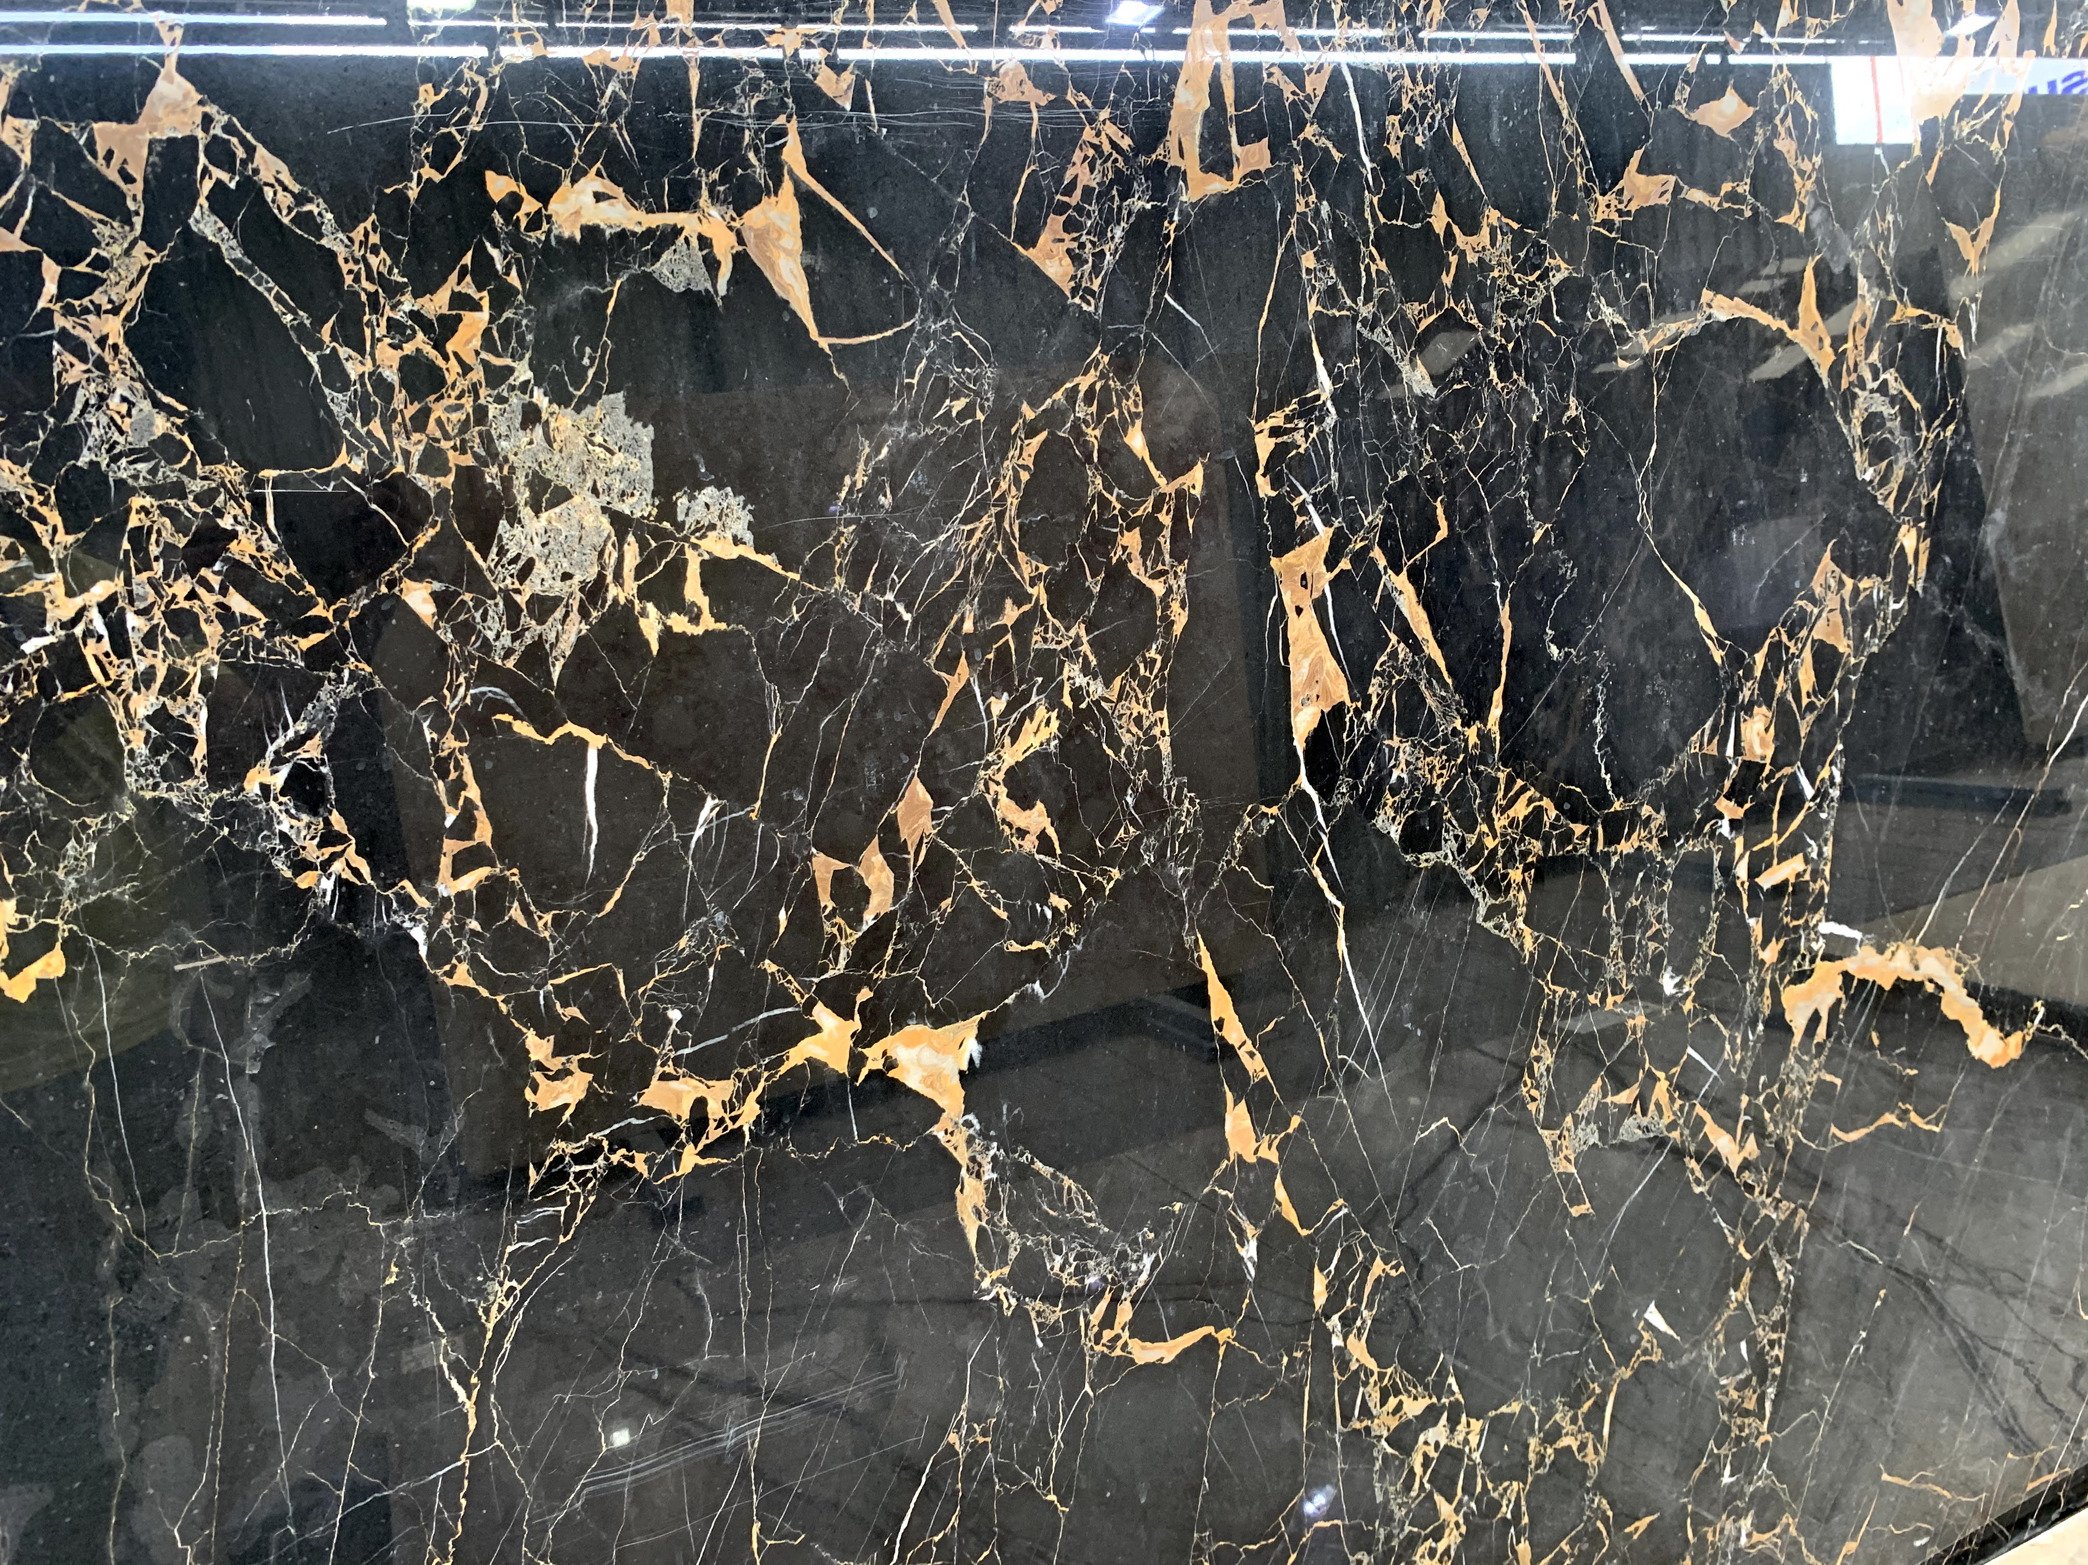
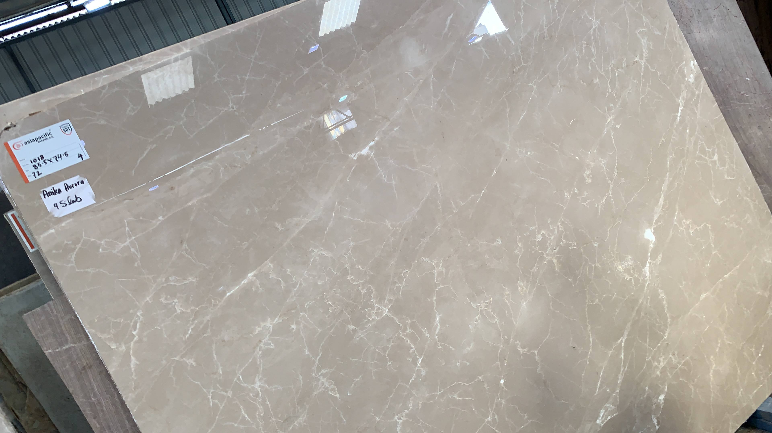
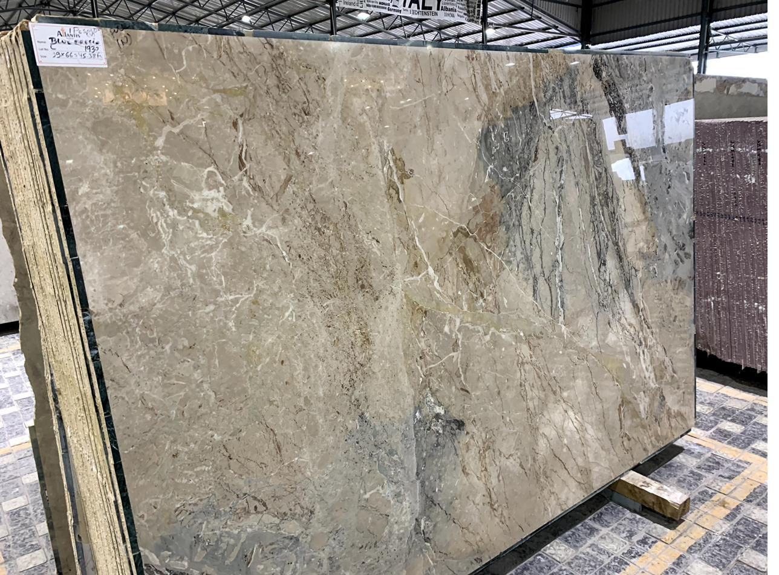
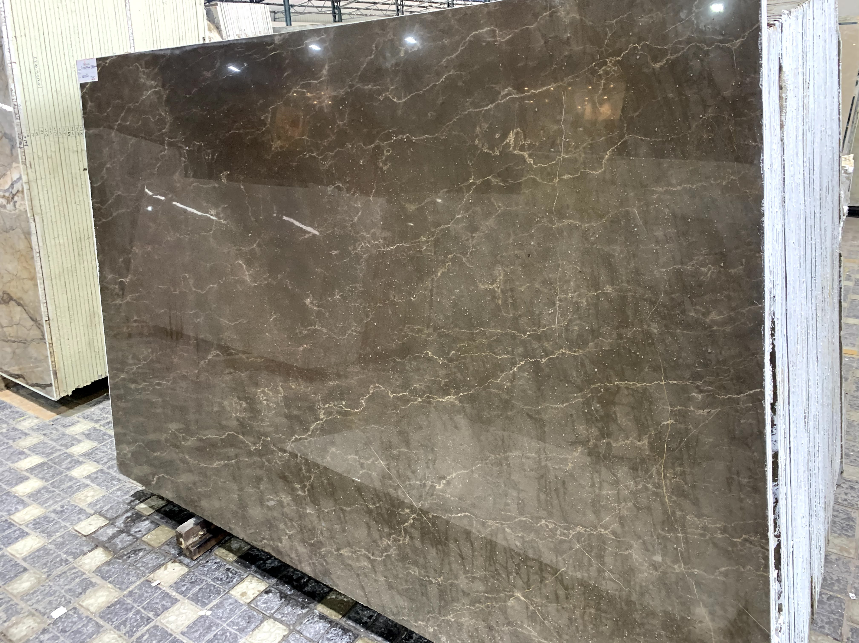
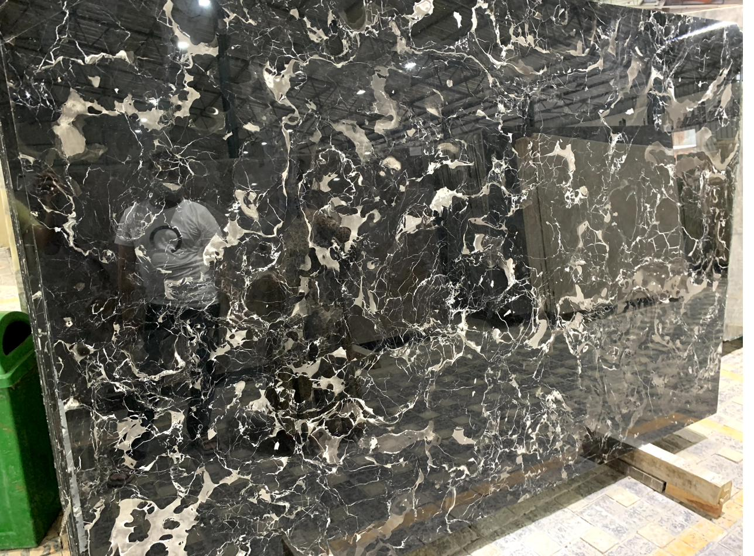
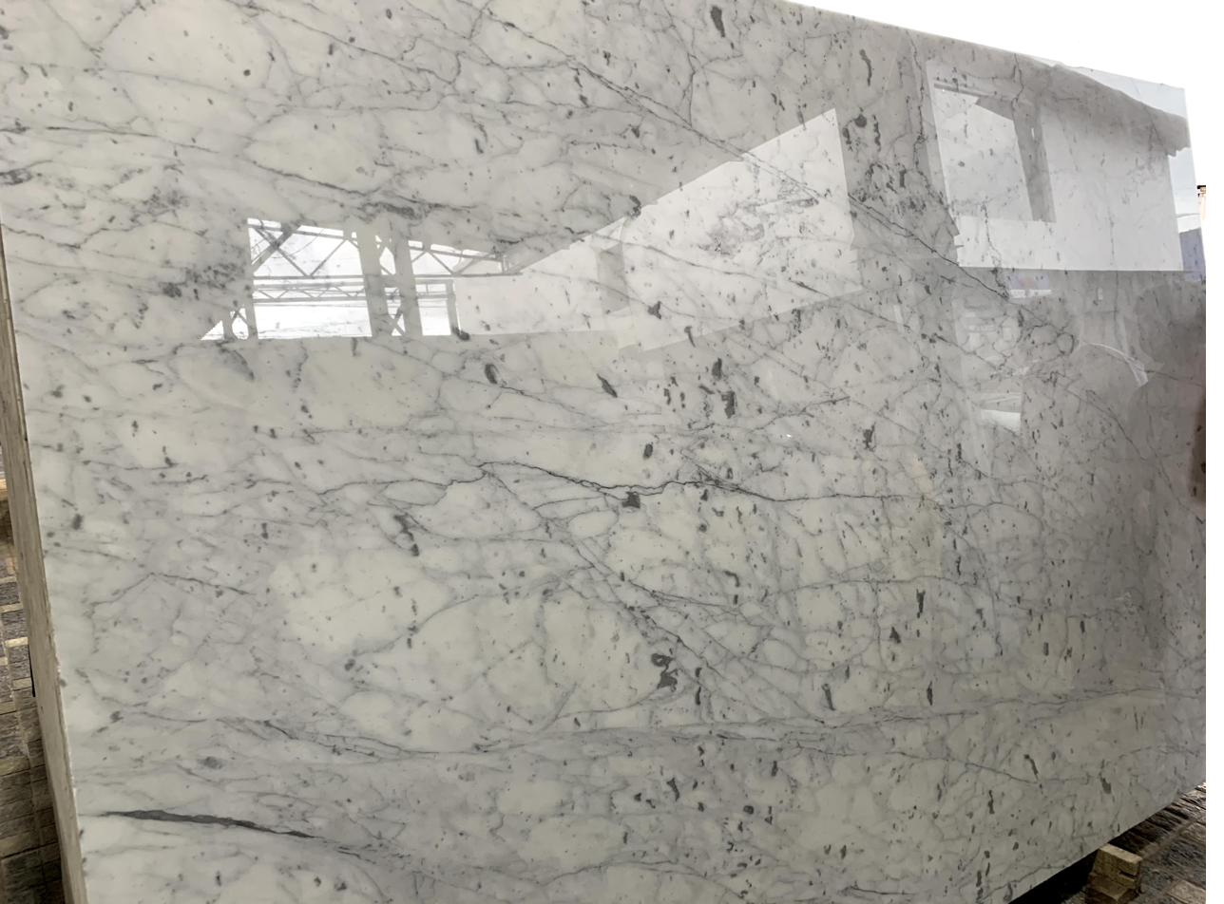
MARBLE & STONE LIBRARY
Italian Marble Selections Used Across the Residence
Golden Portoro
Burberry Beige
Blue Breccia
Jacuzzi cladding
Guest bath
Living / dining spaces
Bronze Armani
Black Rose
Statuario
Room flooring and cladding
Rajat bath
Rajat bath

Slide 17
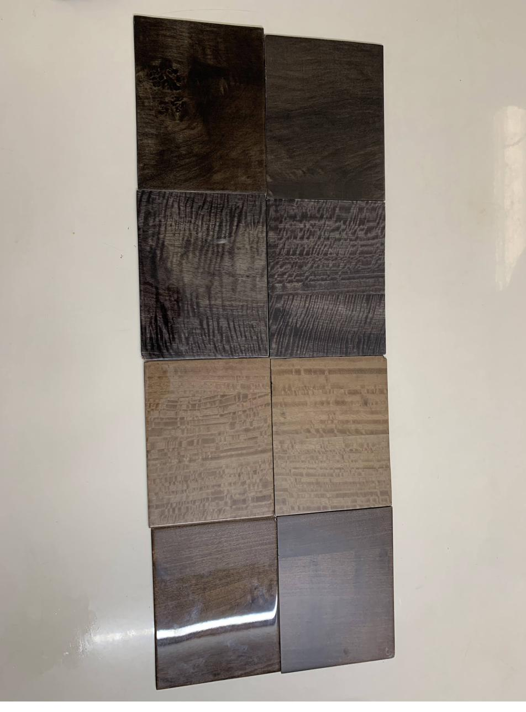
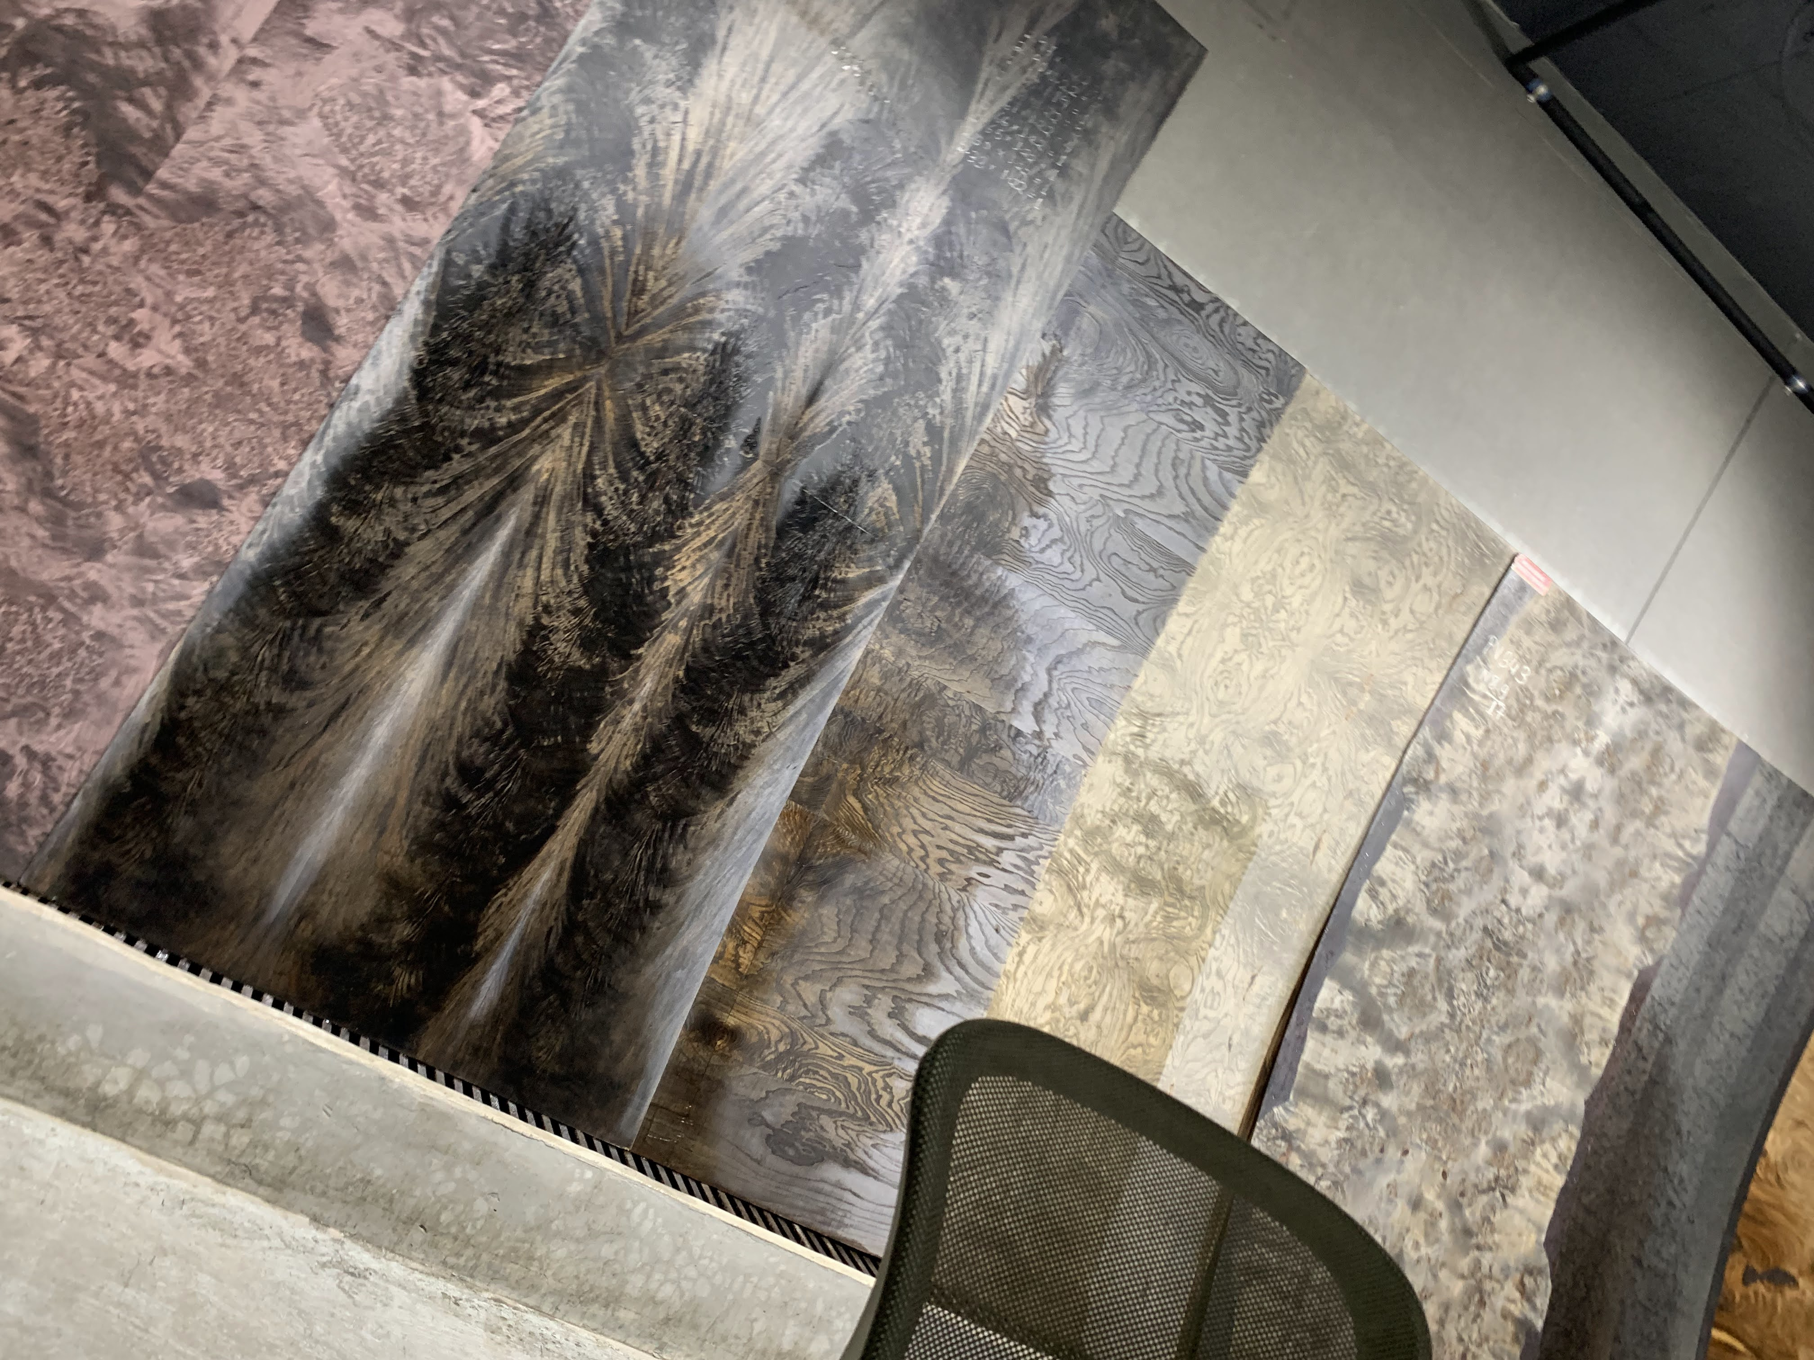
VENEER, FINISHES & PROCESS
Material Selection & Site Execution
Veneer Sample Board
Veneer Selection — Showroom
Site Execution — Work in Progress
Imported veneers were used extensively across wardrobes, panelling and feature walls, selected and finished with ICA Italian wood finishes over Century Ply Club Prime substrate.

Slide 18
BUILDING SYSTEMS
HVAC · Automation · Networking · Security
HVAC
HOME AUTOMATION
NETWORKING & WIFI
Daikin VRV central system — 12 HP capacity
Ducted supply across both floors
Contractor: Continental Cooling
Schneider Home Automation platform
Lighting, HVAC & security integration
Integrator: BT Automation
Grandstream networking devices
Whole-home structured cabling
Integrator: Intouch Networks
SECURITY
WATER SYSTEMS
ELECTRICAL INFRASTRUCTURE
Hik Vision CCTV coverage
Integrated with home automation platform
Integrator: BT Automation
2 × ZeroB Autosoft water softeners
2 × KSB pressure pumps
Contractor: Vikram
Schneider switches & fittings
Polycab wiring throughout
Electrician: Haider

Slide 19
VENDOR & CONTRACTOR INDEX
Consolidated Reference
Category | Brand / Vendor | Site Contractor
Plywood & Carpentry | Century Ply — Club Prime | Saidul Ahmed
Wood Finishes / Paint | ICA Italian Wood Finishes | Sultan
Flooring / Marble Fixing | Italian Marble — 6 varieties (see Marble Library) | Suman
Electrical Fittings / Wiring | Schneider / Polycab | Haider
Plumbing | KSB pumps, ZeroB Autosoft softeners | Vikram
False Ceiling | — | Irshad Alam
Sanitaryware & Fittings | Kohler, Jaquar Artize | —
Modular Kitchen | Blu Kitchens · Häfele / Hettich hardware | —
Kitchen Appliances | LG (refrigerator), Faber (hob/chimney), Samsung (oven) | —
Curtains & Upholstery | Seven Designs | —
Audio-Video | Watteffects · BenQ, ELAC, Denon | —
Home Automation | Schneider · BT Automation (integrator) | —
Networking | Grandstream · Intouch Networks (integrator) | —
Security (CCTV) | Hik Vision | —
HVAC | Daikin (12 HP central VRV) · Continental Cooling | —
Windows & Glass | Fenesta (windows) · Saint-Gobain (glass) | —
Lighting | Lafit | —
Jacuzzi | Oyster | —
Wallpaper | Sabyasachi | —

Slide 20
Vendor and procurement records available for reference.
MEGHMANI RESIDENCE · Rajat Tibrewal

